Slide 1
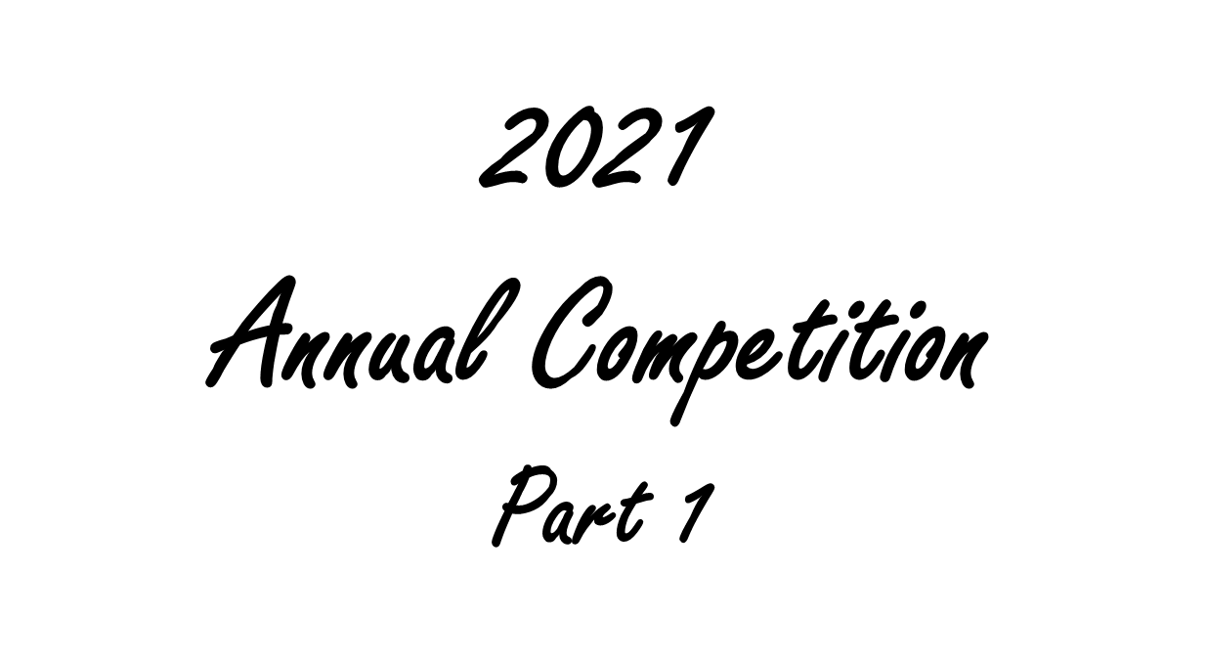
Candid, Action, Decisive Moment, Street Photography
Architecture, Technical Record
Creative
Cultivated Flowers/Plants
Foreign Travel
People & Portraits
#1 EARLY MORNING ROW

Slide 2
Candid, Action, Decisive Moment, Street Photography
Sue Carey Trophy

Slide 3
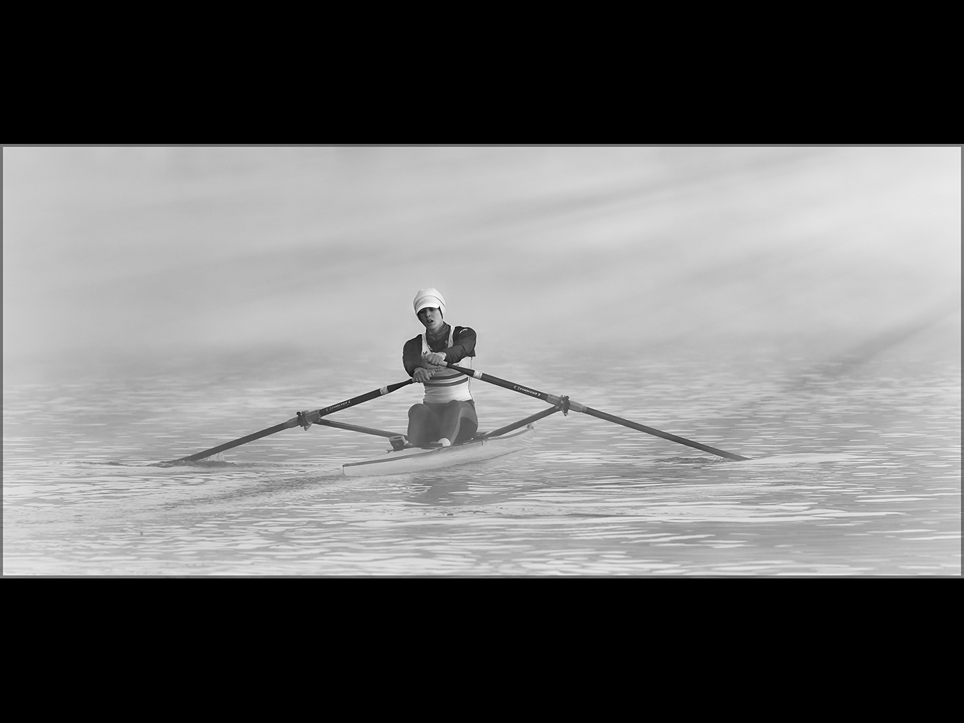
#1
EARLY MORNING ROW

Slide 4
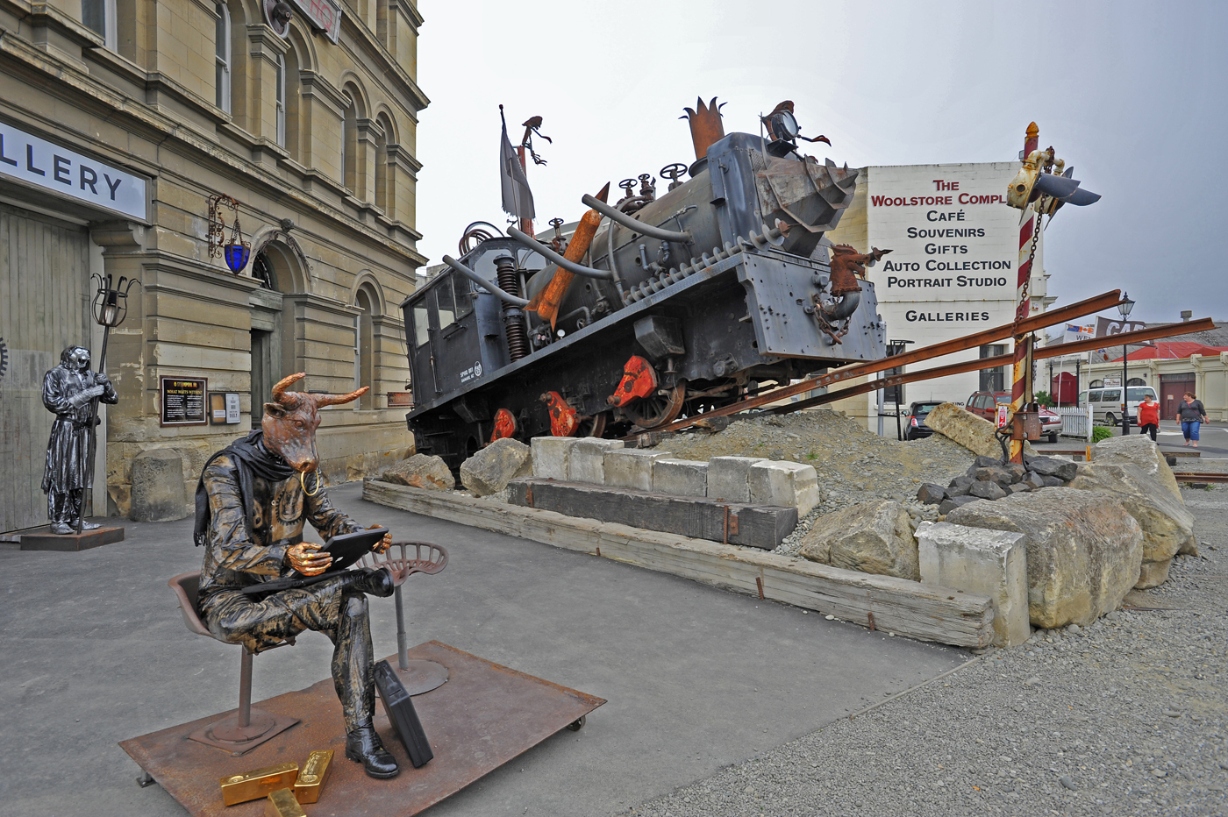
#2 STEAM PUNK
#1 EARLY MORNING ROW

Slide 5
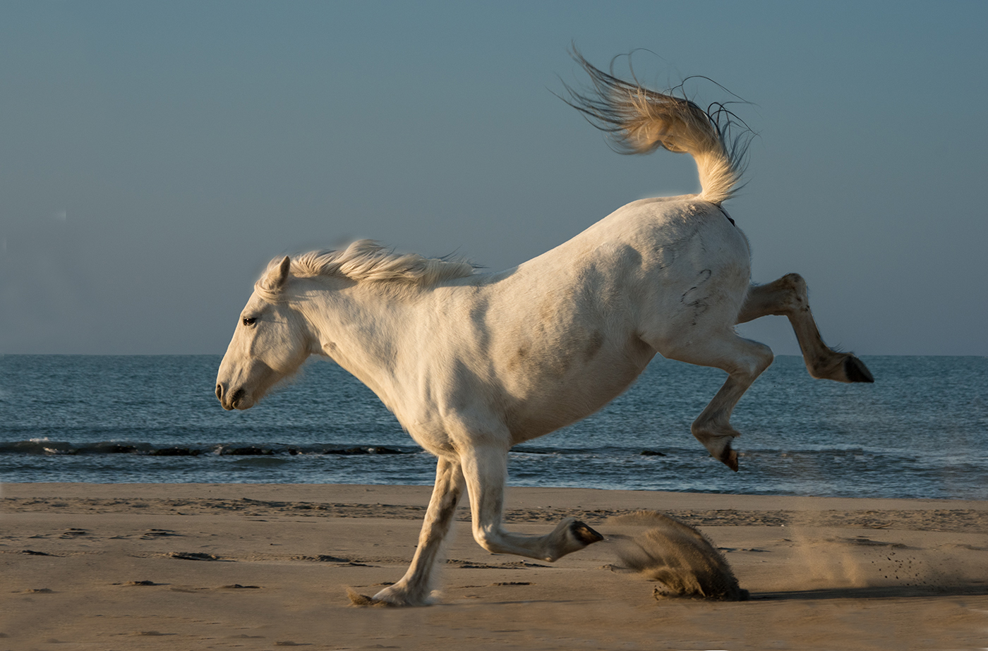
#3 BUCKING HORSE
#1 EARLY MORNING ROW

Slide 6
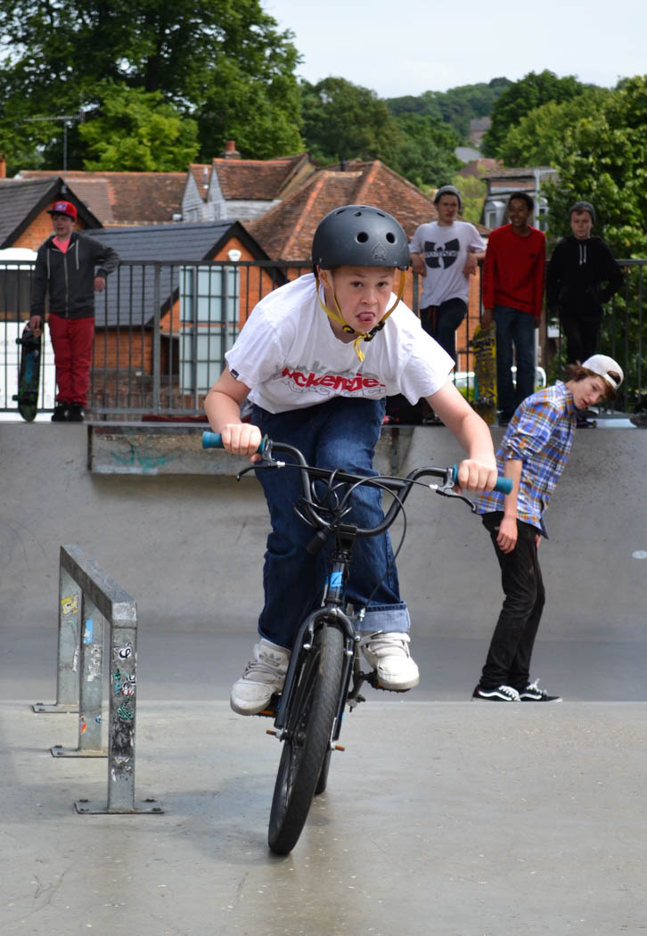
#4 DETERMINATION
#1 EARLY MORNING ROW

Slide 7
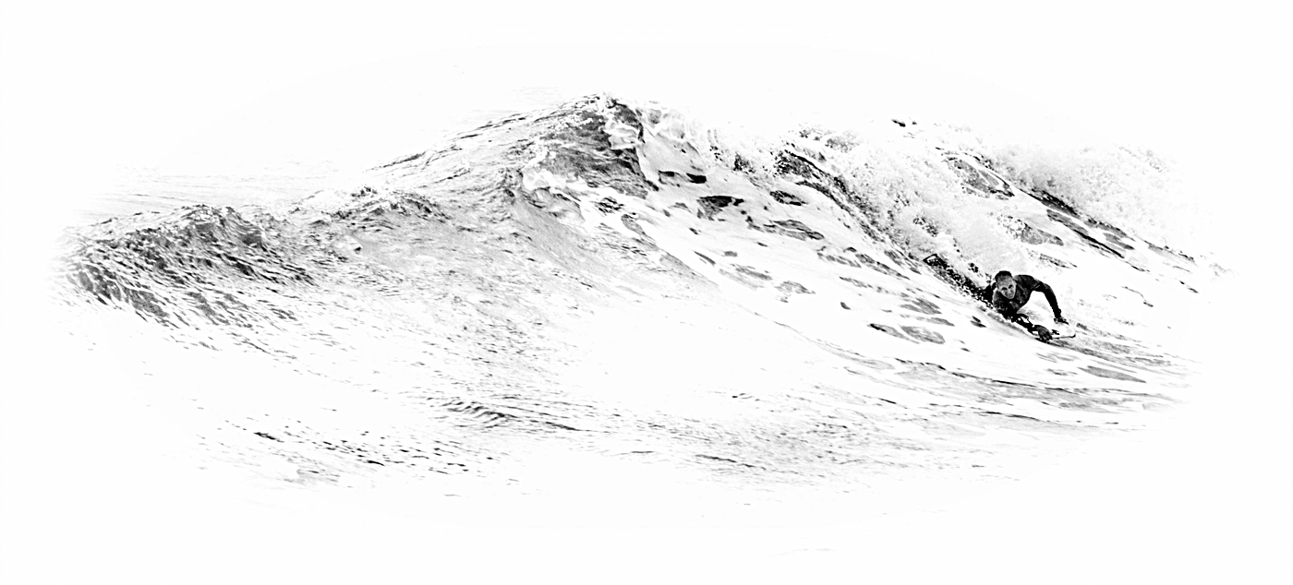
#5
BODY SURFER
#1 EARLY MORNING ROW

Slide 8
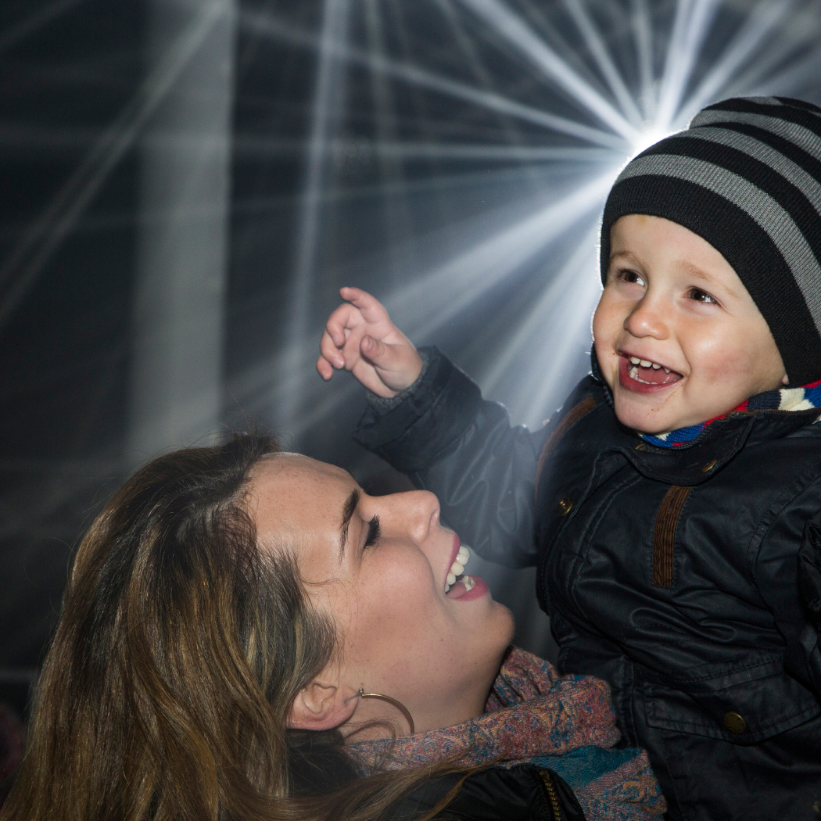
#6
IMI & THEO
CHRISTMAS LIGHTS
#1 EARLY MORNING ROW

Slide 9
Winner of the
Sue Carey Trophy
#1 EARLY MORNING ROW

Slide 10
Pat Begley #3 BUCKING HORSE
#1 EARLY MORNING ROW

Slide 11
ARCHITECTURE, TECHNICAL RECORD
PERCY THOMSON Trophy

Slide 12
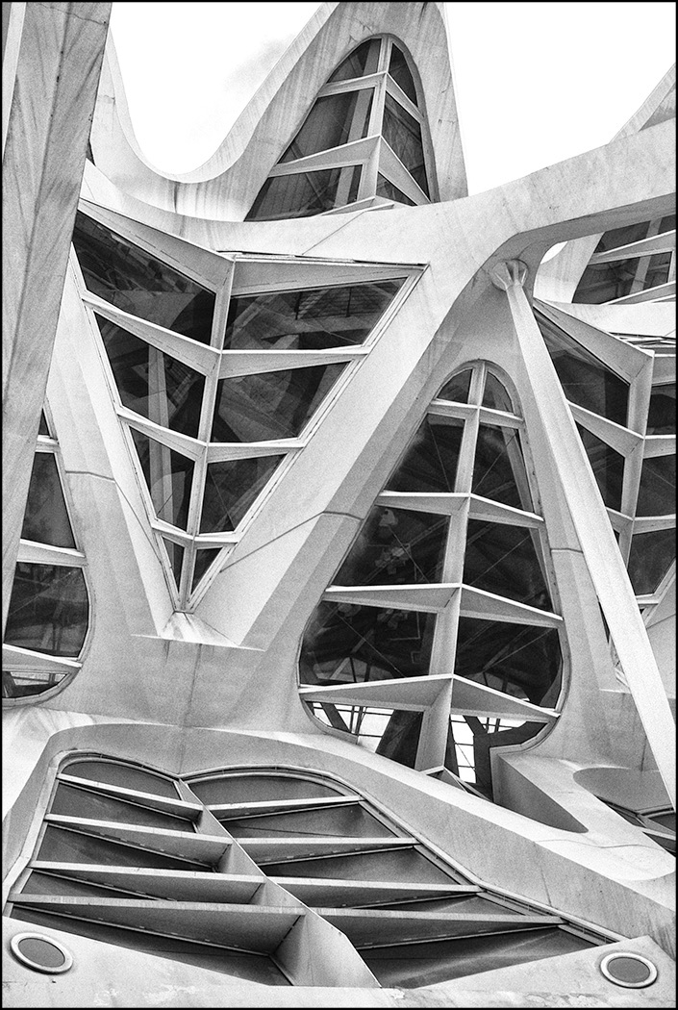
#1
VERTIGINOUS LINES
#1 EARLY MORNING ROW

Slide 13
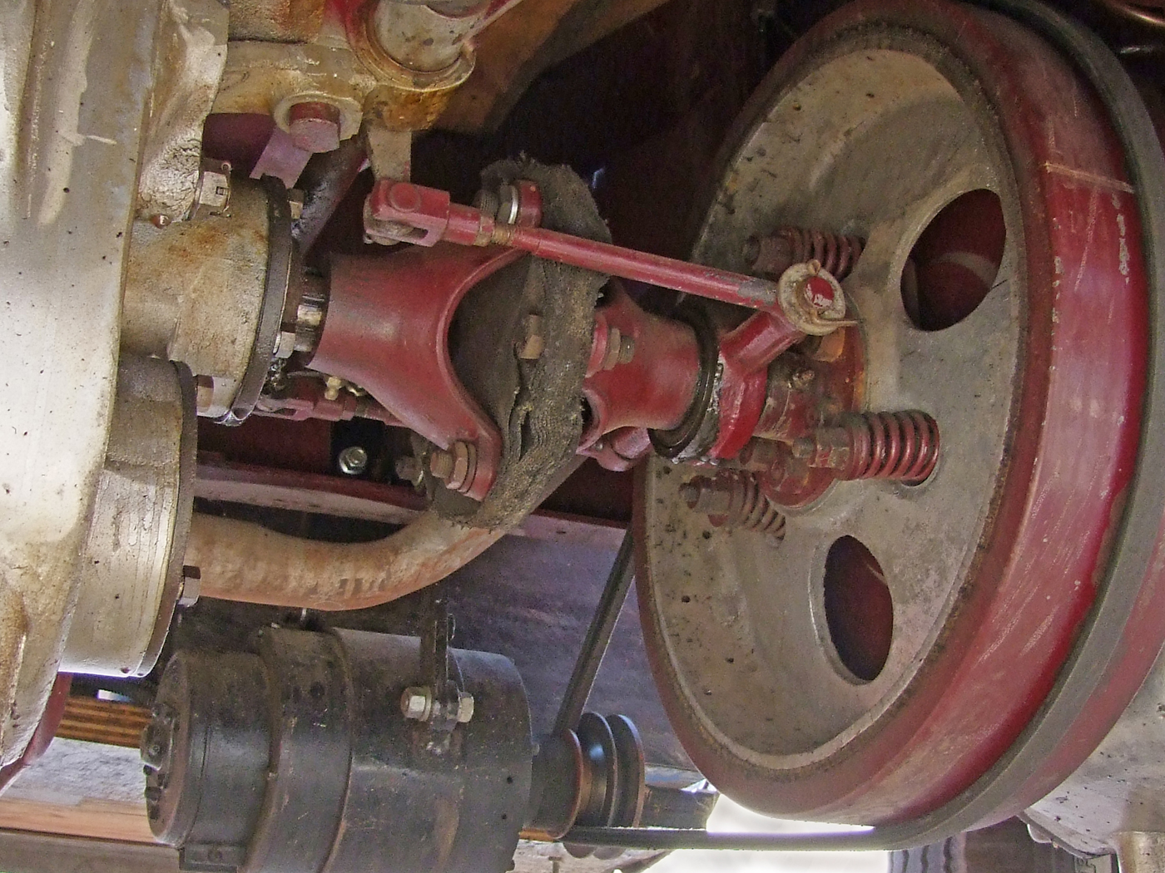
#2
OLD LORRY
RUNNING GEAR
#1 EARLY MORNING ROW

Slide 14
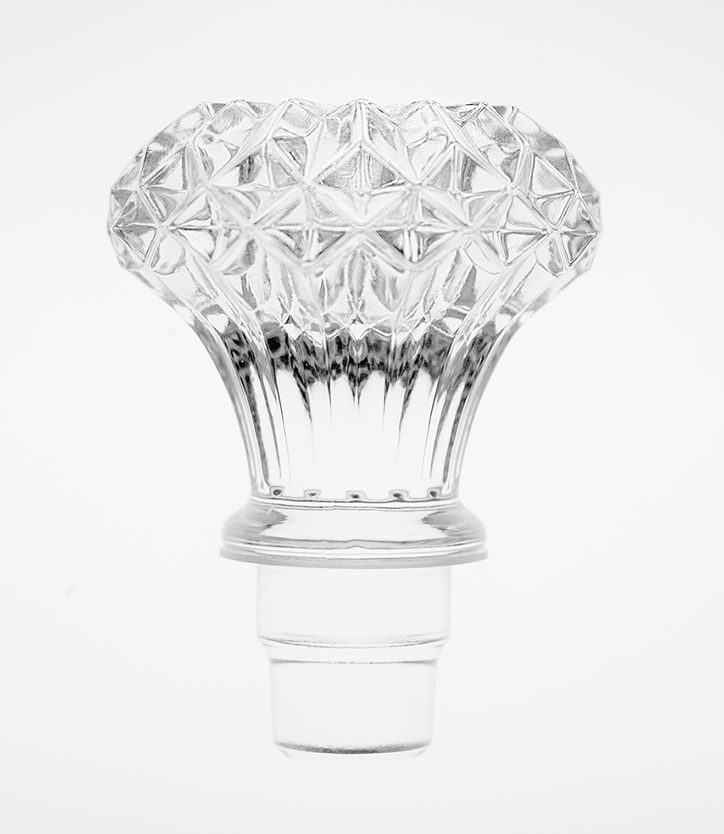
#3
HIGH KEY
CUT GLASS
#1 EARLY MORNING ROW

Slide 15
#4
ELEMENTS OF A BRIDGE
#1 EARLY MORNING ROW

Slide 16
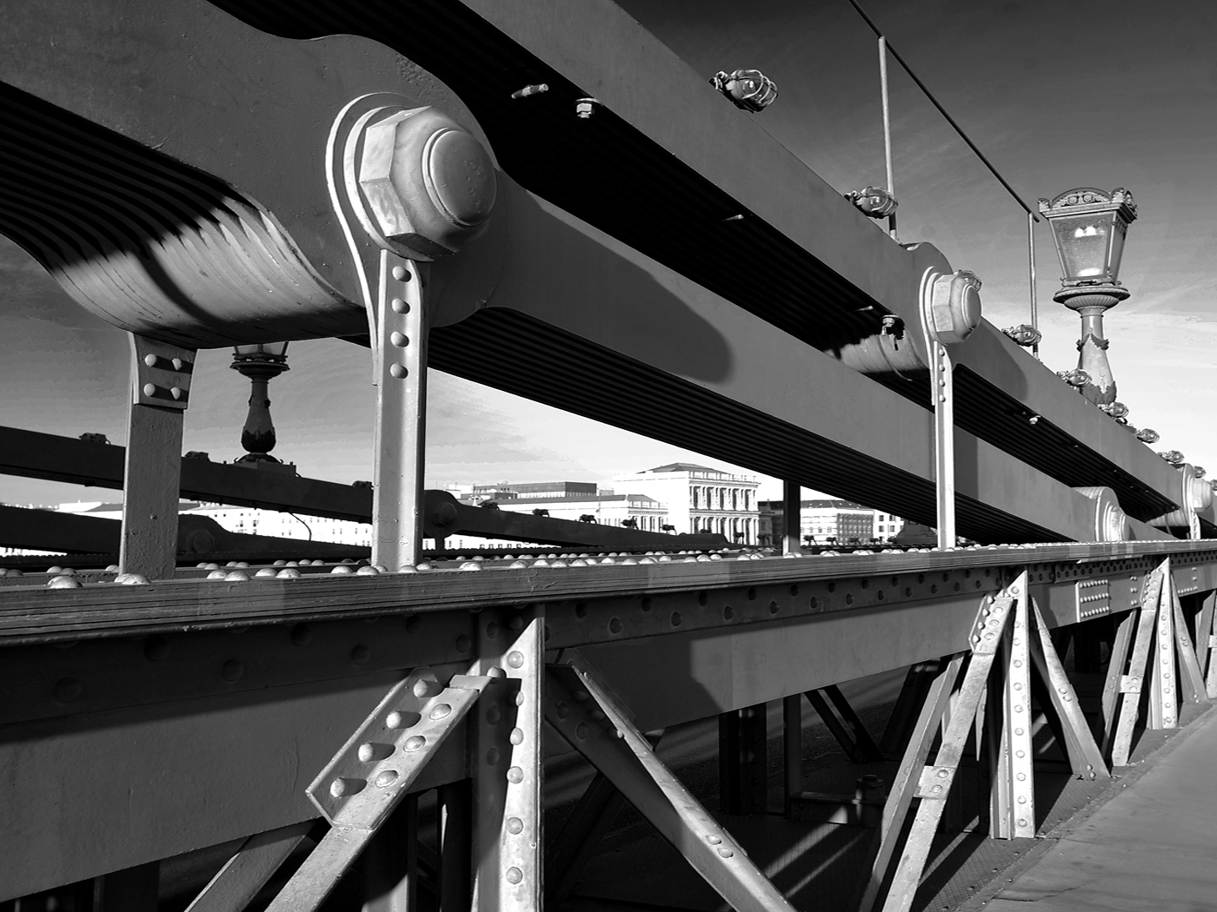
#5
BRIDGE GIRDERS
#1 EARLY MORNING ROW

Slide 17
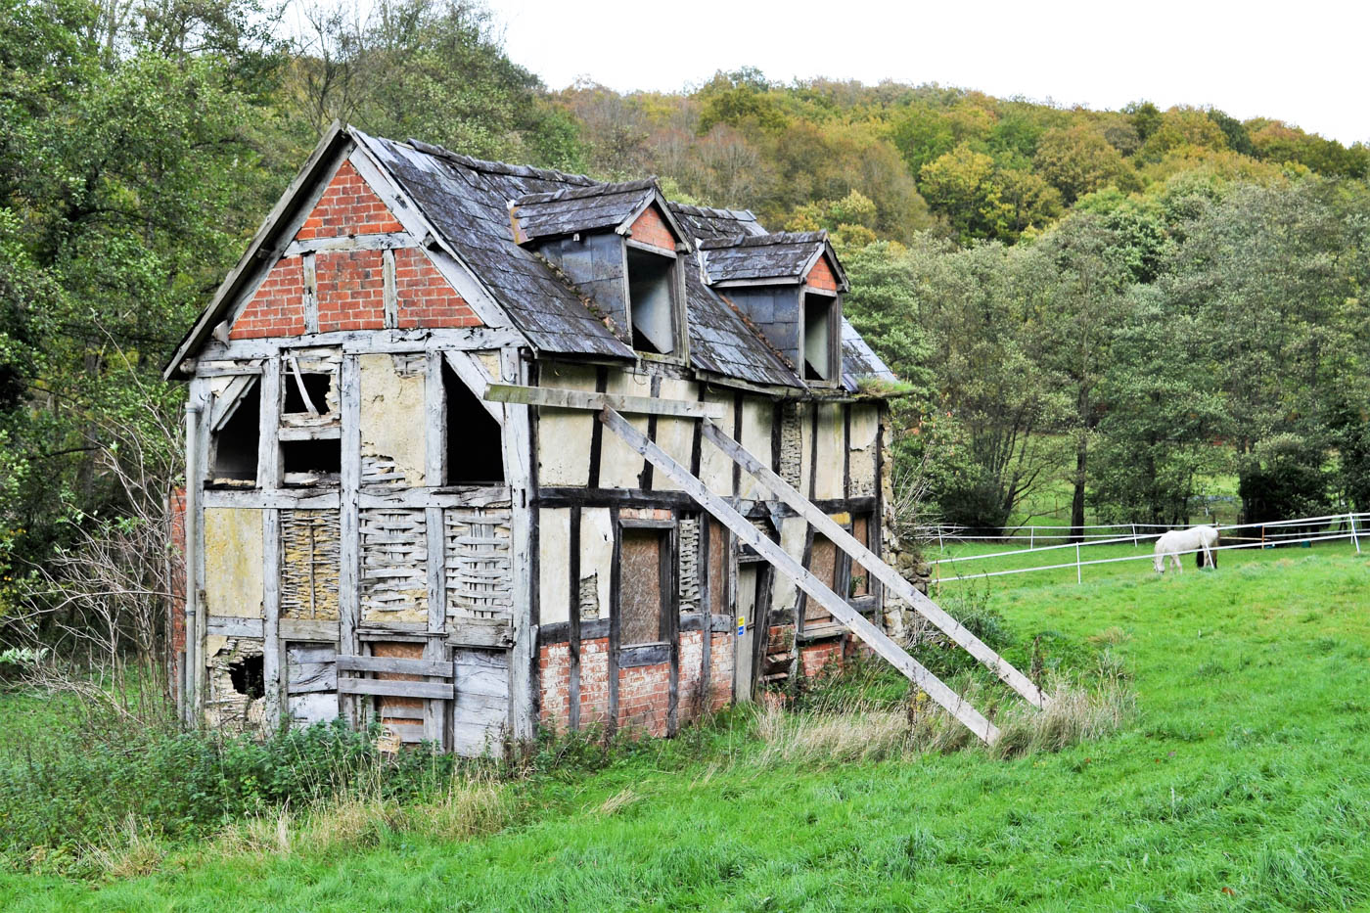
#6
OFFERS INVITED
IN NEED OF MODERNIZATION!
#1 EARLY MORNING ROW

Slide 18
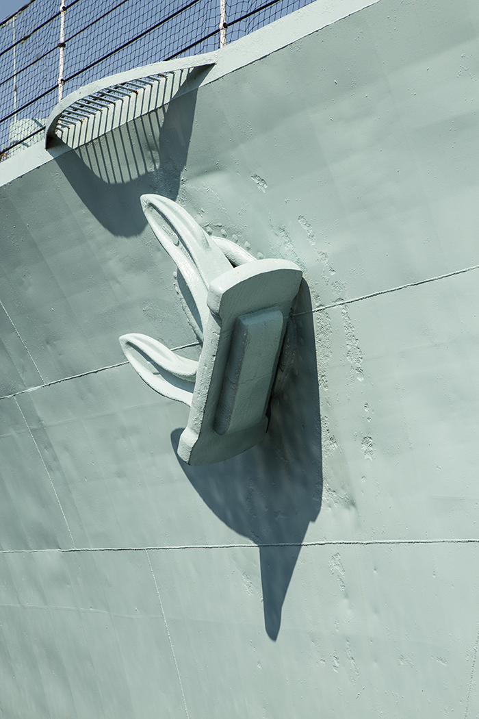
#7
THE ANCHOR
#1 EARLY MORNING ROW

Slide 19
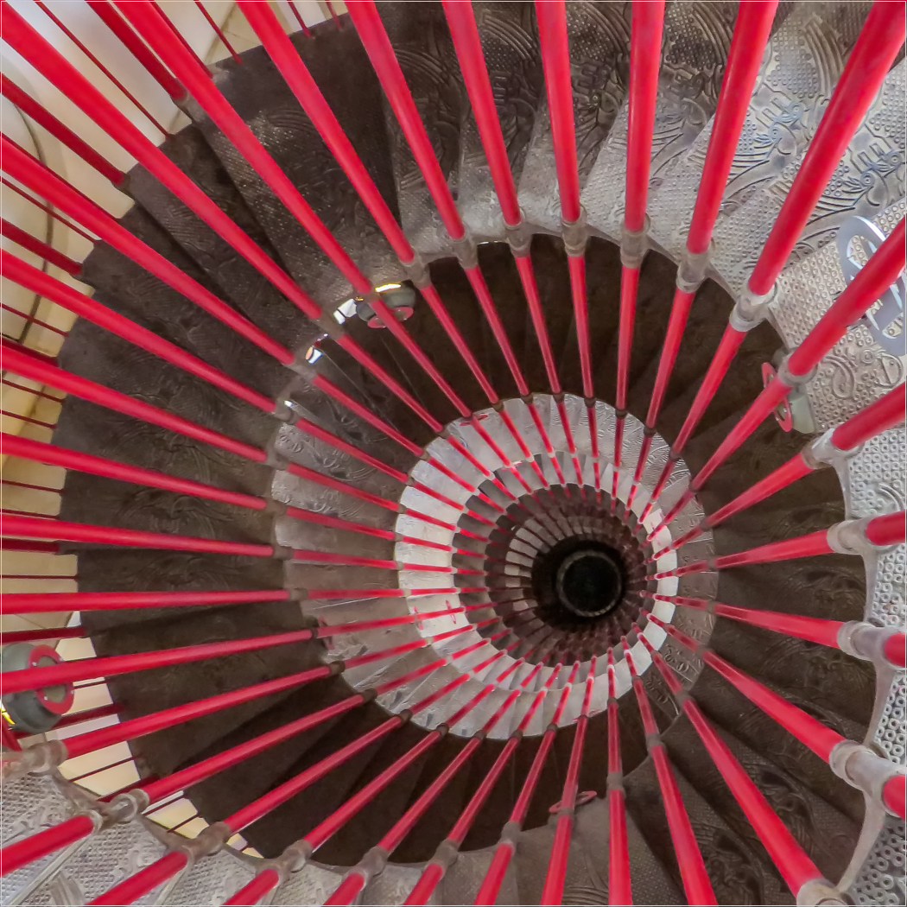
#8
SPIRAL STAIRCASE
#1 EARLY MORNING ROW

Slide 20
Highly Commended
#1 EARLY MORNING ROW

Slide 21
HILARY PICKERSGILL
#4
ELEMENTS OF A BRIDGE
#1 EARLY MORNING ROW

Slide 22
Winner of the
Percy Thomson Trophy
#1 EARLY MORNING ROW

Slide 23
Carole Dixon
#1
VERTIGINOUS LINES
#1 EARLY MORNING ROW

Slide 24
CREATIVE
Castle Cup

Slide 25
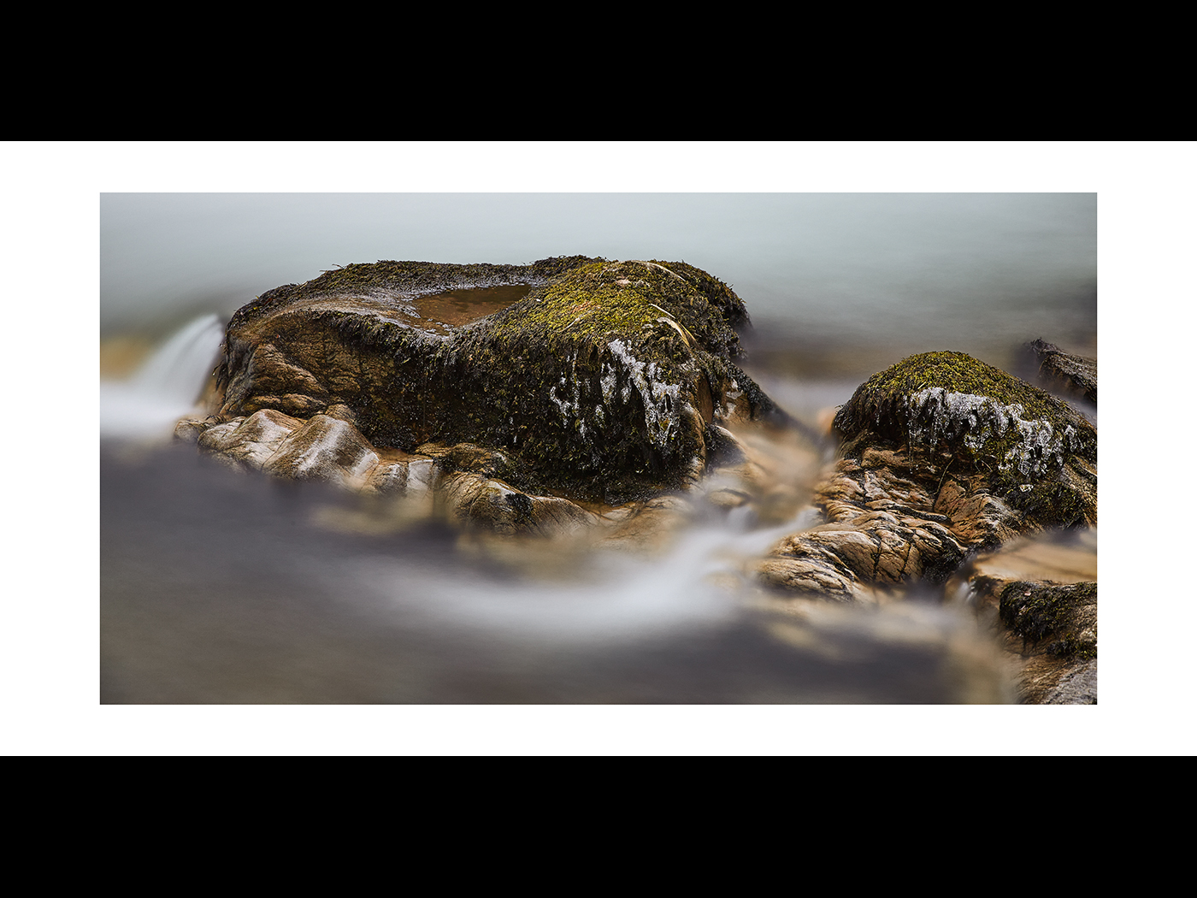
#1
WINTERY ROCKS
#1 EARLY MORNING ROW

Slide 26
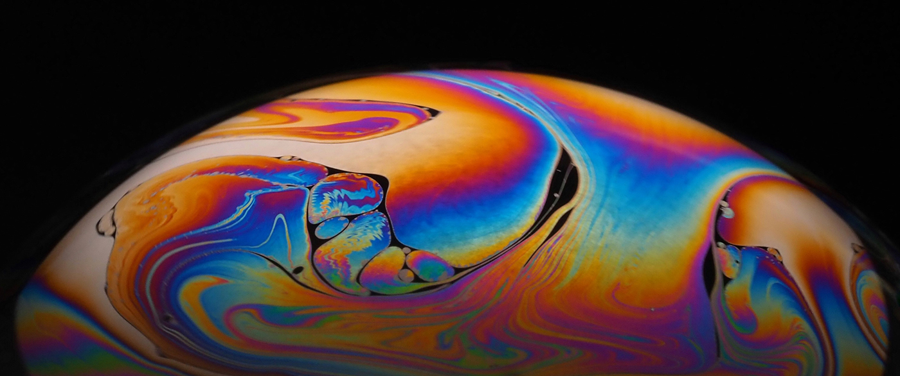
#2
BUBBLE
#1 EARLY MORNING ROW

Slide 27
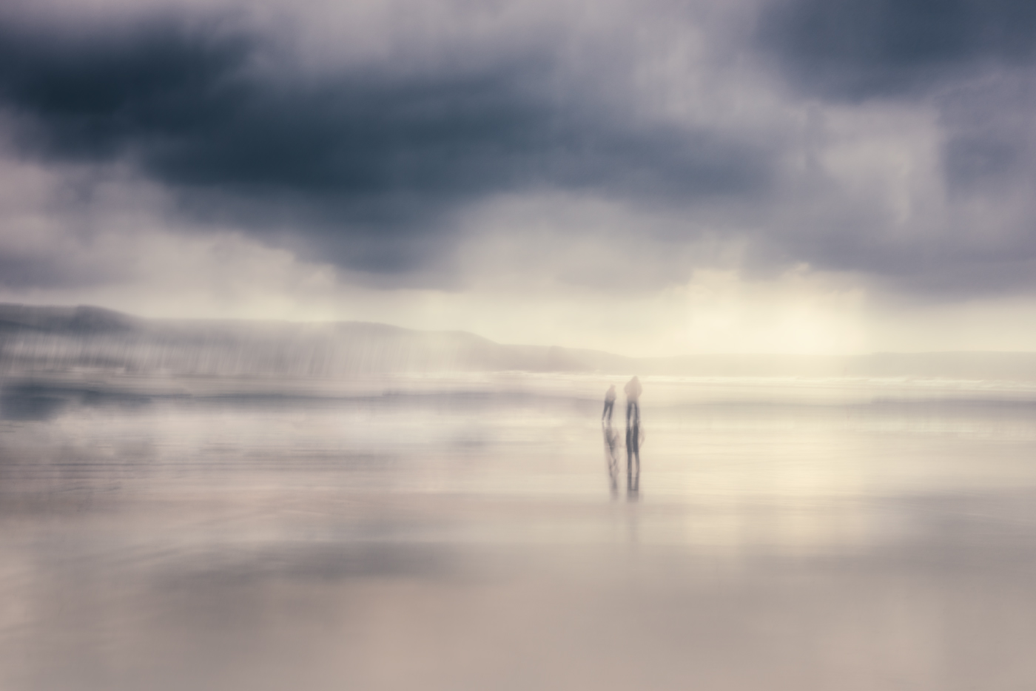
#3
BRAVING THE STORM
#1 EARLY MORNING ROW

Slide 28
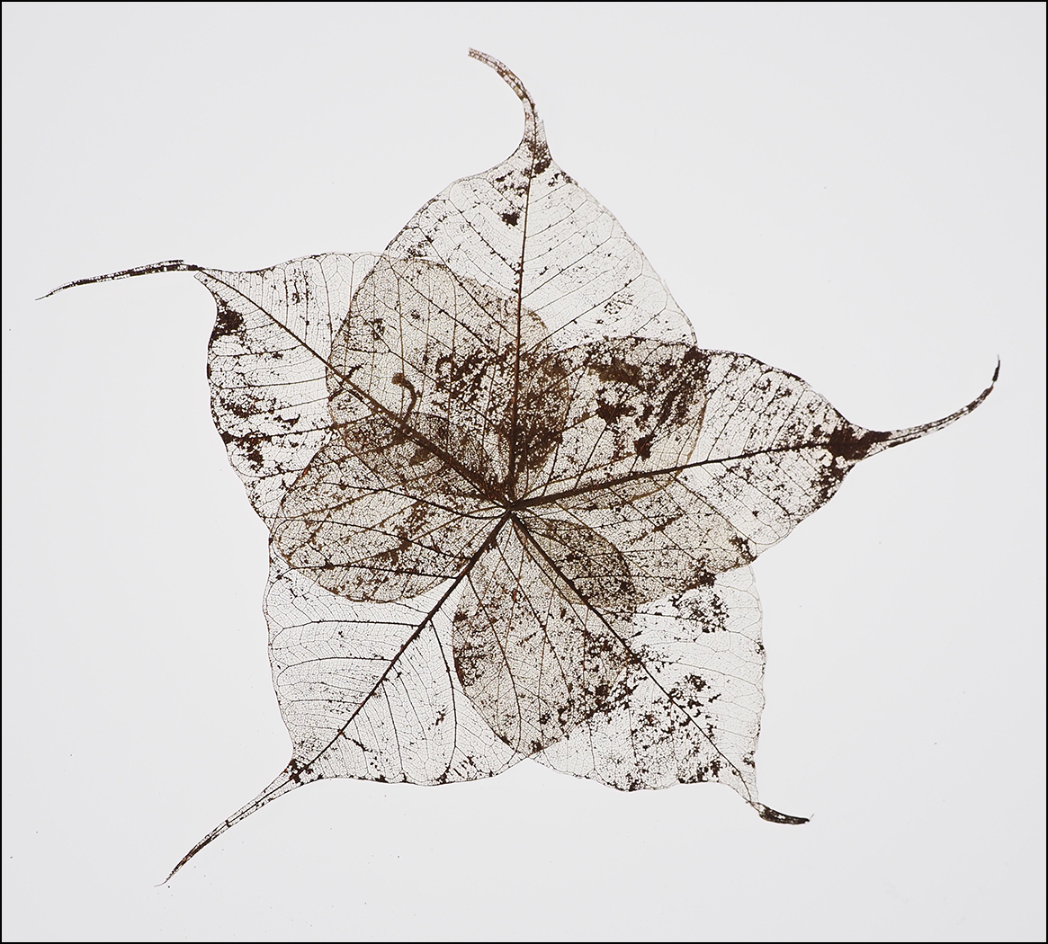
#4
LEAF SKELETON
#1 EARLY MORNING ROW

Slide 29
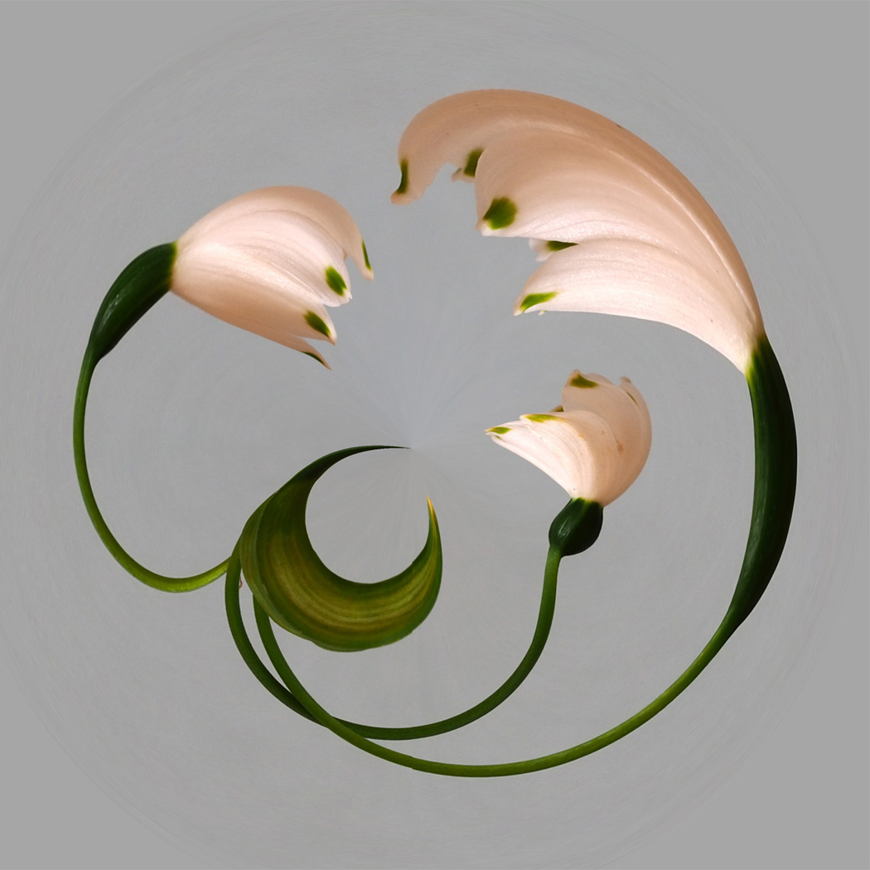
#5
SNOWDROPS
#1 EARLY MORNING ROW

Slide 30
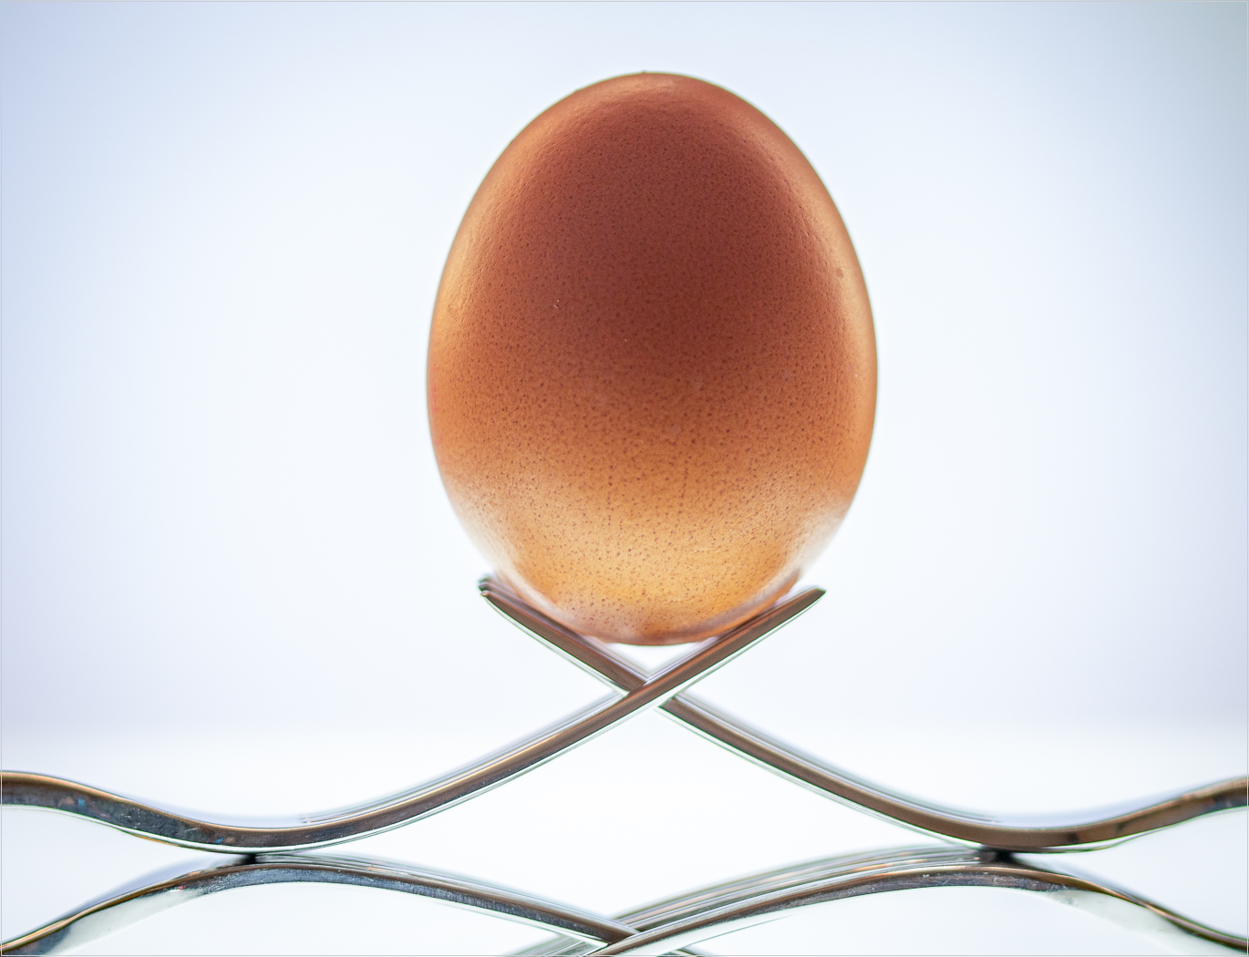
#6
EGG ON FORKS
#1 EARLY MORNING ROW

Slide 31
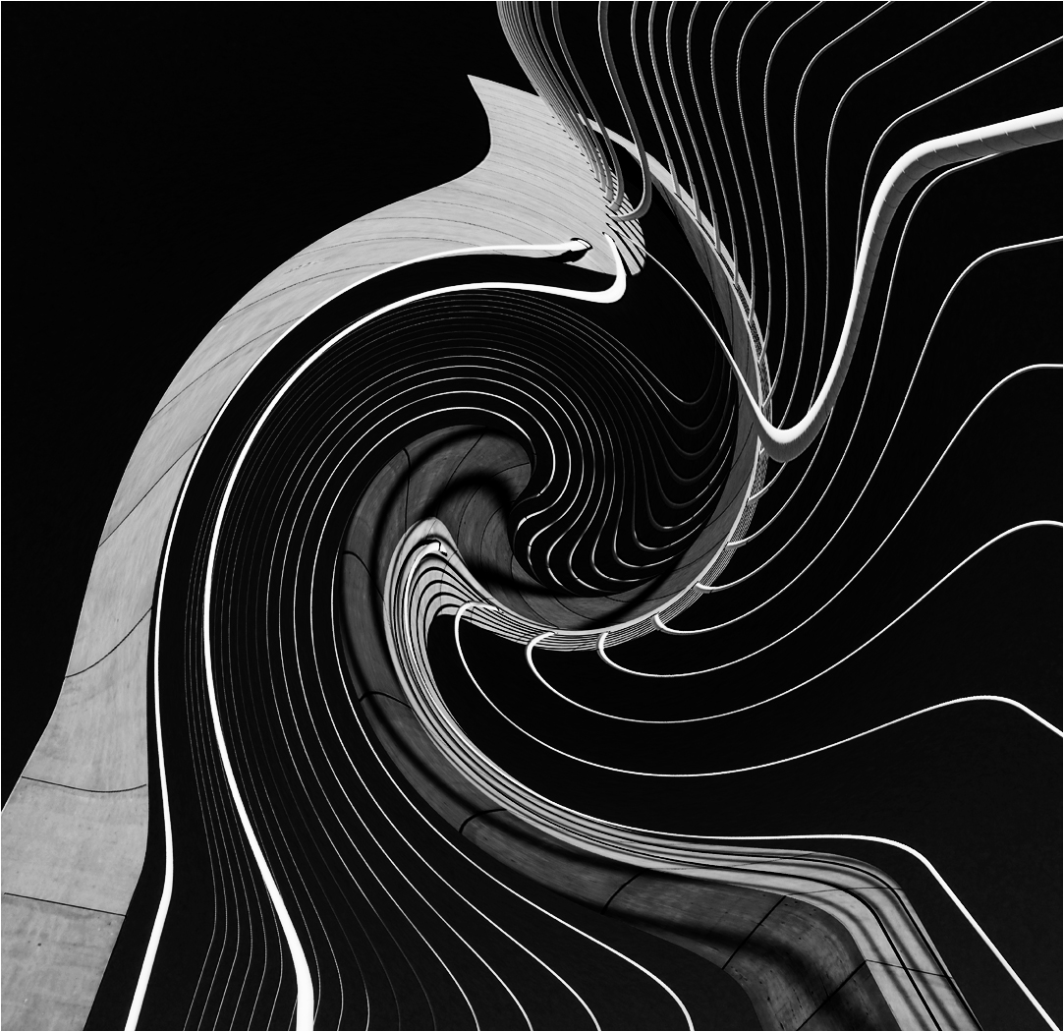
#7
BRIDGE DISTORTION
#1 EARLY MORNING ROW

Slide 32
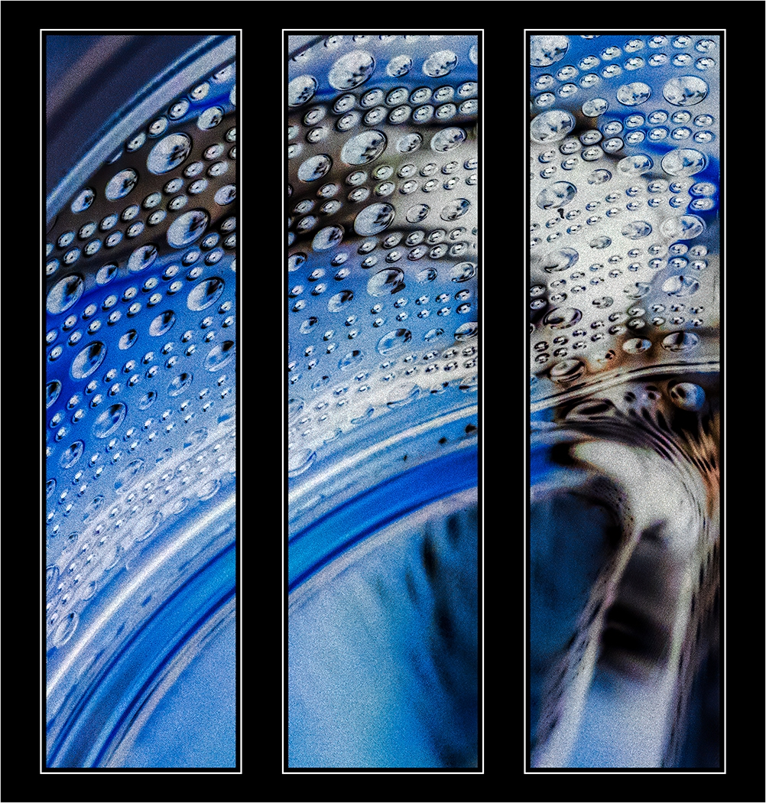
#8
BLUE WAVE
#1 EARLY MORNING ROW

Slide 33
#9
GIN & TONIC
#1 EARLY MORNING ROW

Slide 34
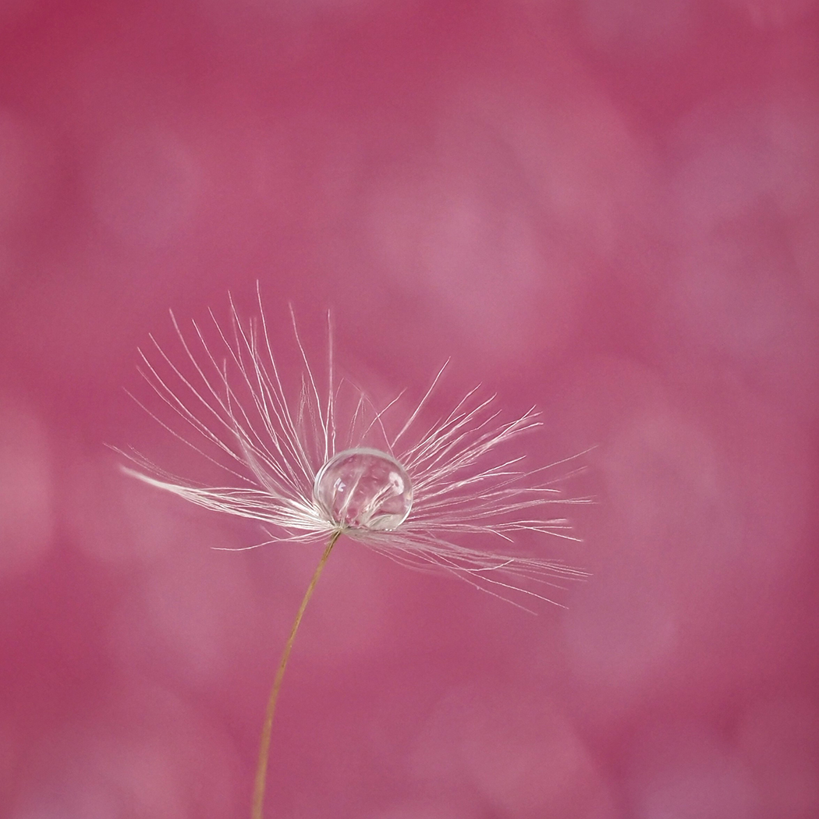
#10
PINK DANDELION SEED
#1 EARLY MORNING ROW

Slide 35
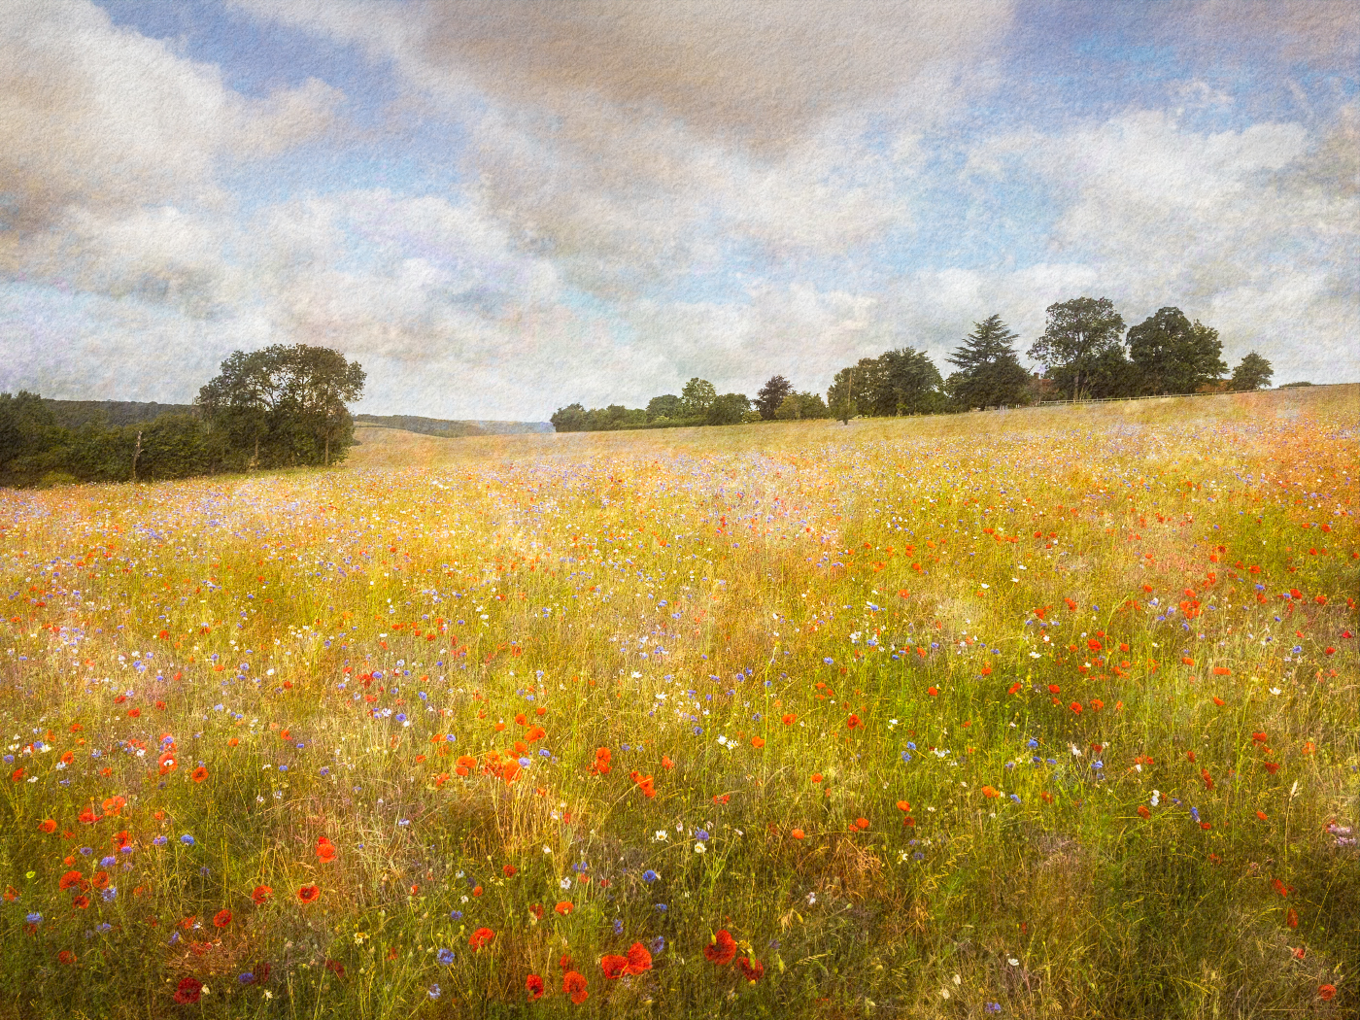
#11
CHILTERN IMPRESSION
#1 EARLY MORNING ROW

Slide 36
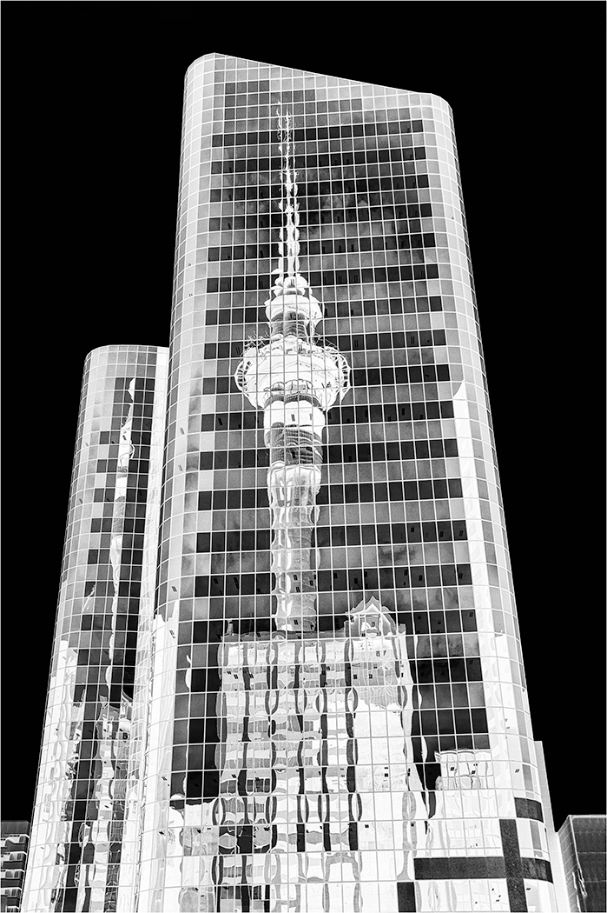
#12
AUKLAND TOWER REFLECTION
#1 EARLY MORNING ROW

Slide 37
Commended
#1 EARLY MORNING ROW

Slide 38
ALLAN MARSHALL
#1
WINTERY ROCKS
#1 EARLY MORNING ROW

Slide 39
Highly Commended
#1 EARLY MORNING ROW

Slide 40
Deena Theaker
#5
SNOWDROPS
#1 EARLY MORNING ROW

Slide 41
Winner of the
Castle cup
#1 EARLY MORNING ROW

Slide 42
Hilary Pickersgill
#8
BLUE WAVE
#1 EARLY MORNING ROW

Slide 43
CULTIVATED FLOWERS / PLANTS
Floral Cup

Slide 44
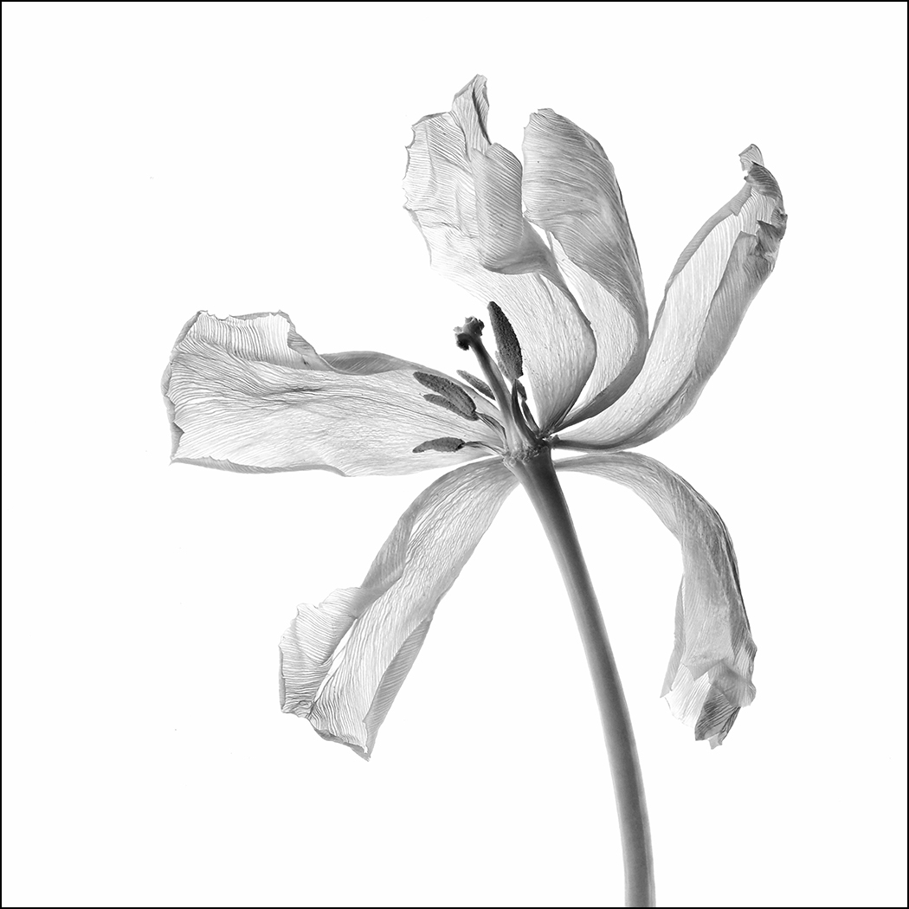
#1
FADED TULIP
#1 EARLY MORNING ROW

Slide 45
#2
TULIP
#1 EARLY MORNING ROW

Slide 46
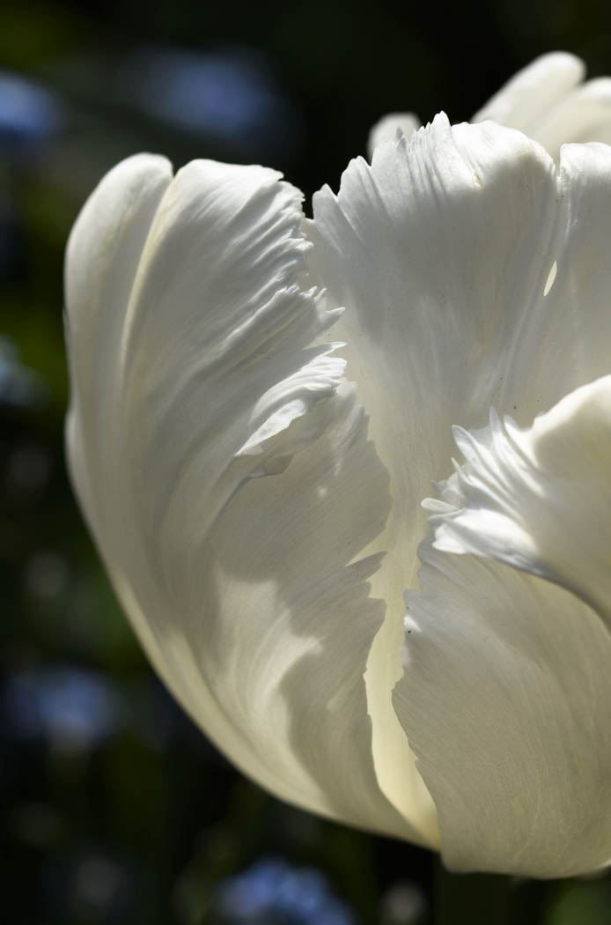
#3
TULIP – WHITE SWAN
#1 EARLY MORNING ROW

Slide 47
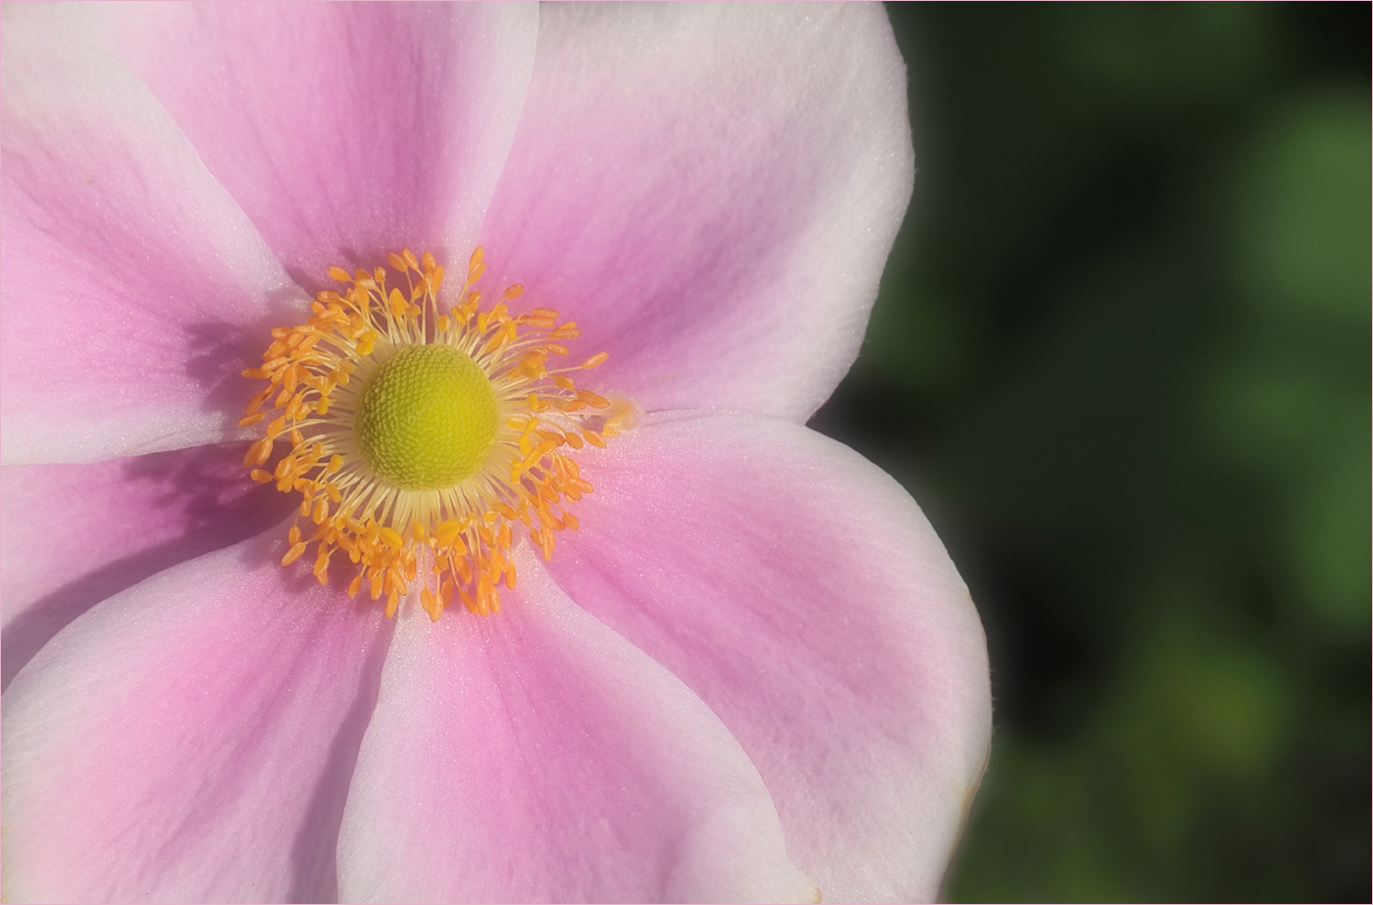
#4
JAPANESE ANEMONE
#1 EARLY MORNING ROW

Slide 48
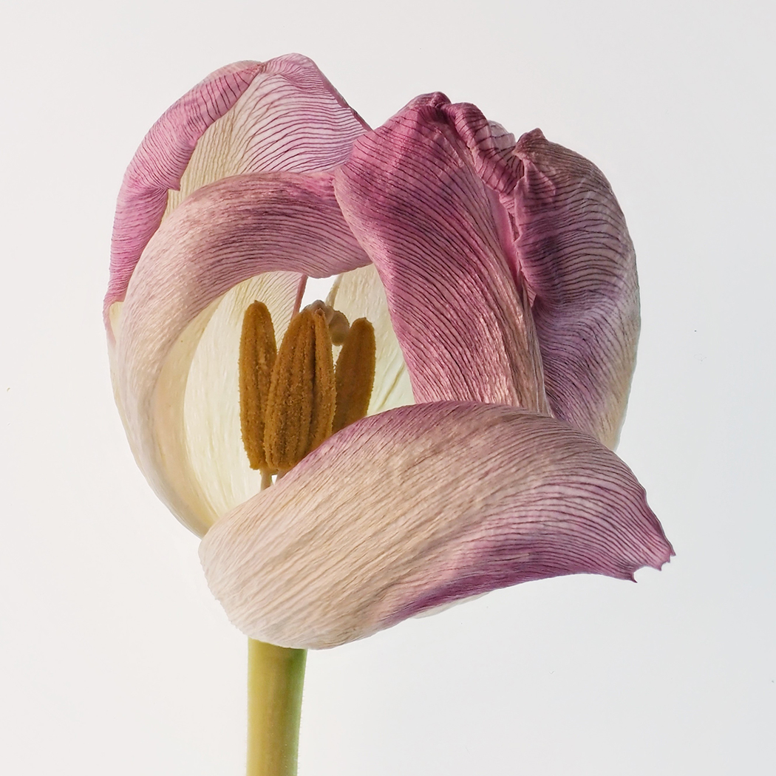
#5
TULIP PORTRAIT
#1 EARLY MORNING ROW

Slide 49
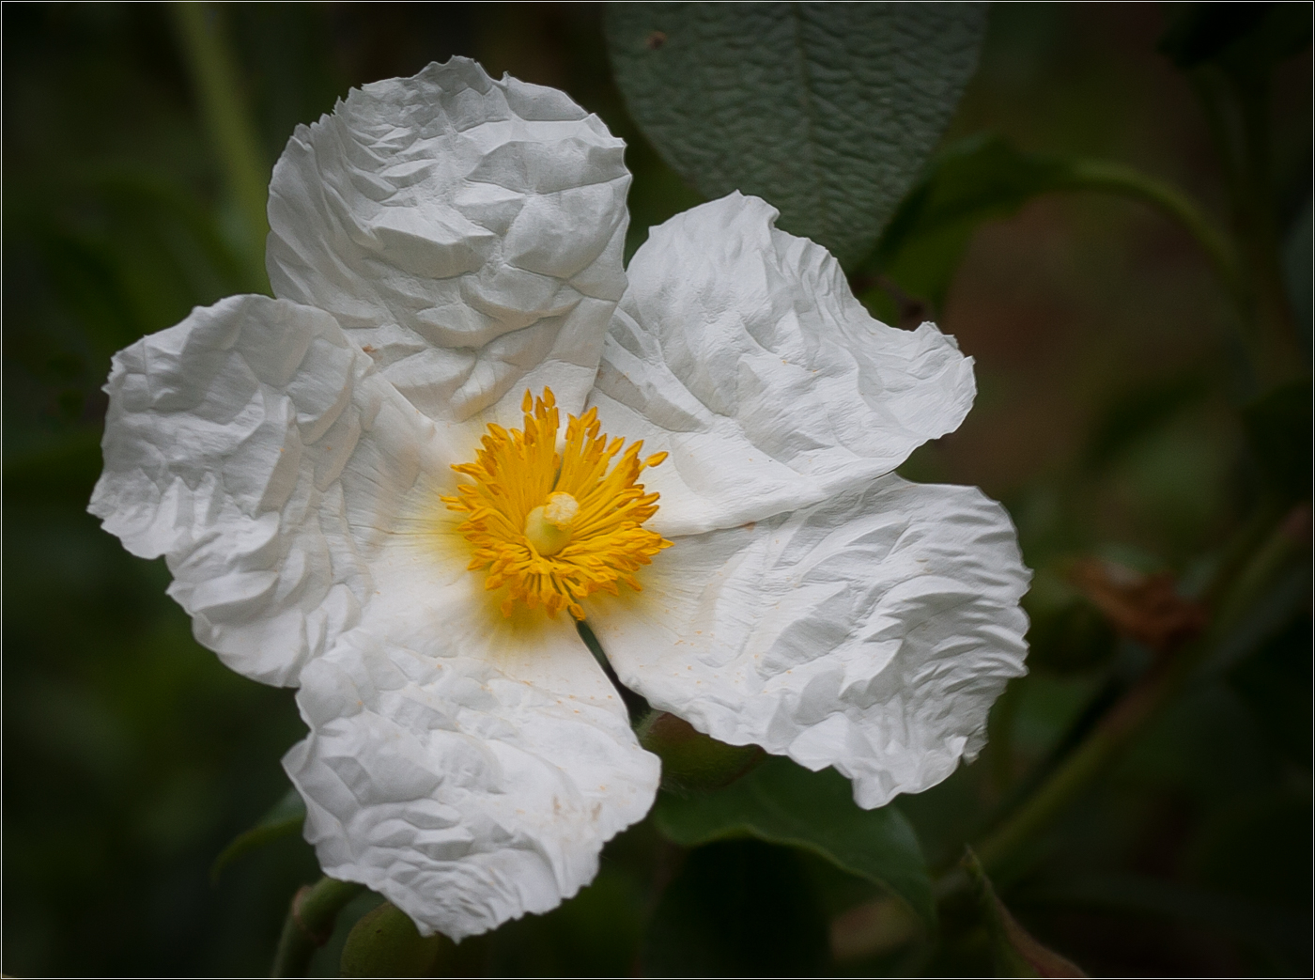
#6
CRUMPLED ROSE
#1 EARLY MORNING ROW

Slide 50
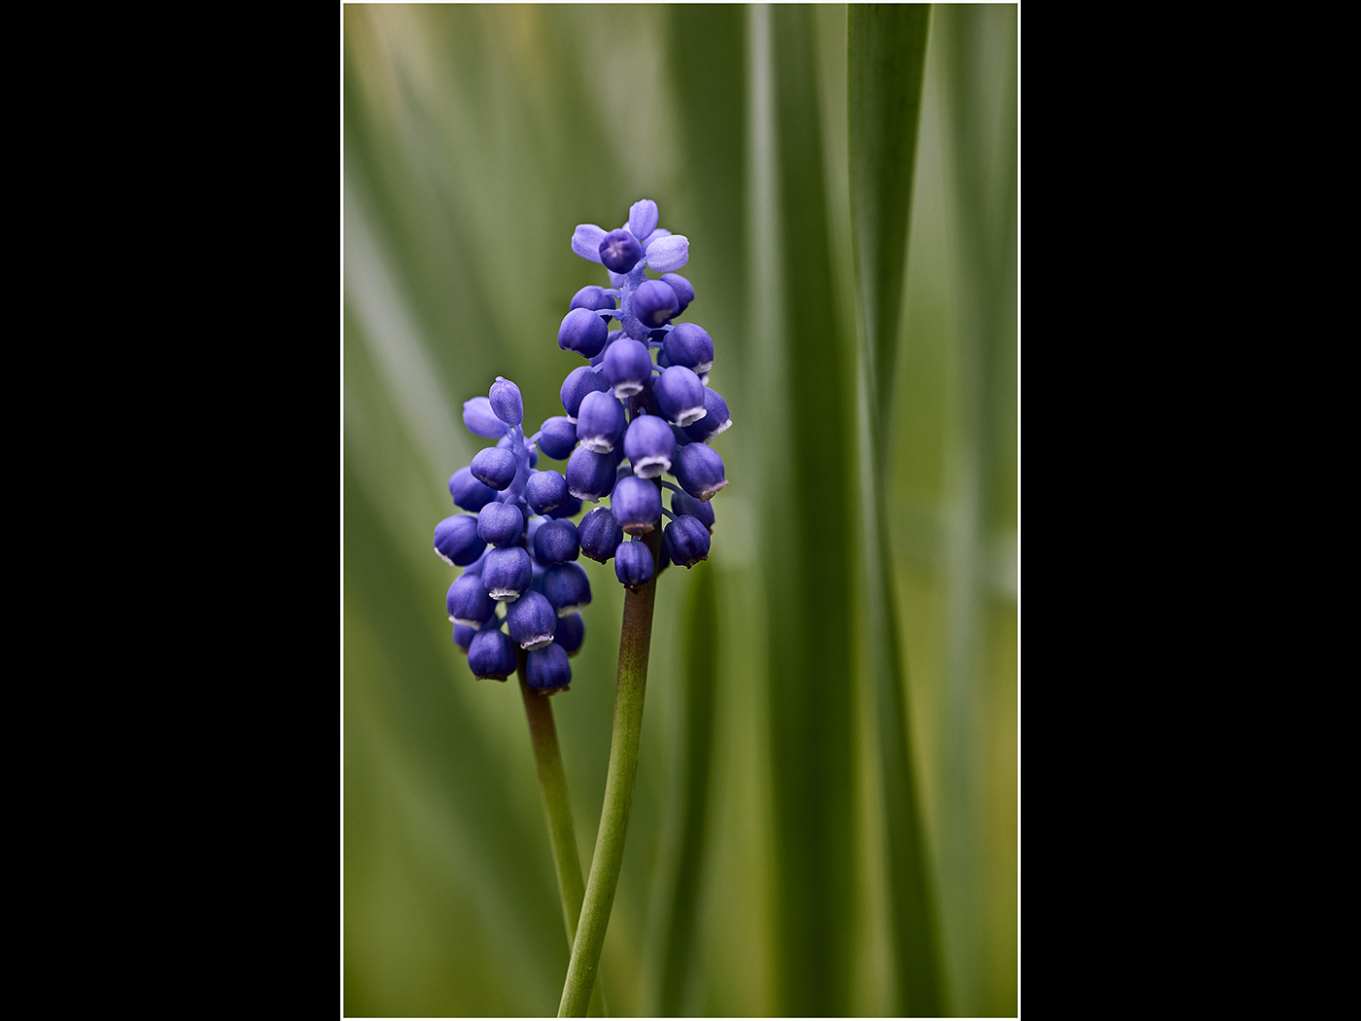
#7
GRAPE HYACINTH
#1 EARLY MORNING ROW

Slide 51
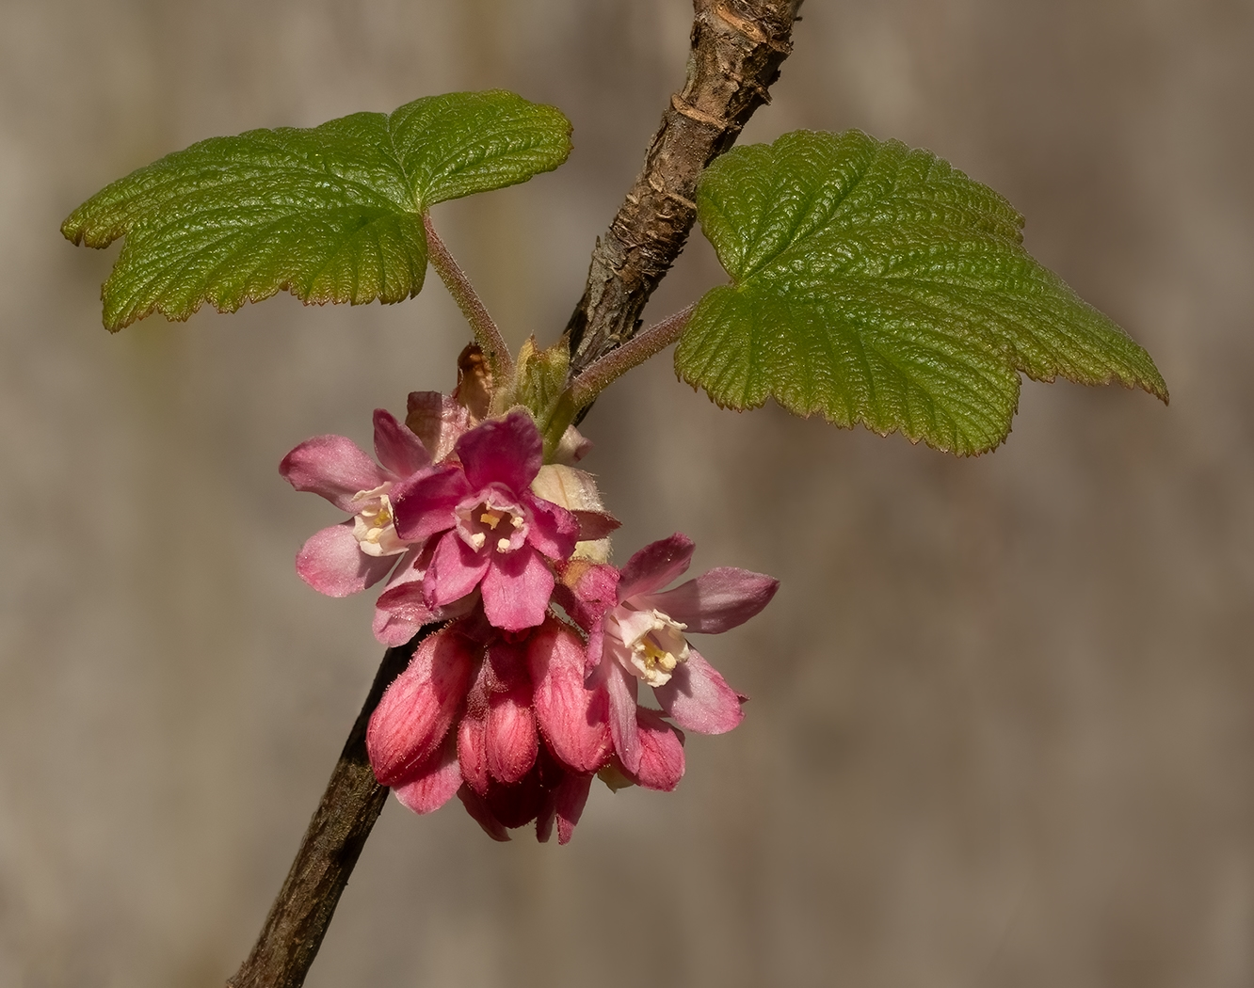
#8
FLOWERING CURRANT
#1 EARLY MORNING ROW

Slide 52
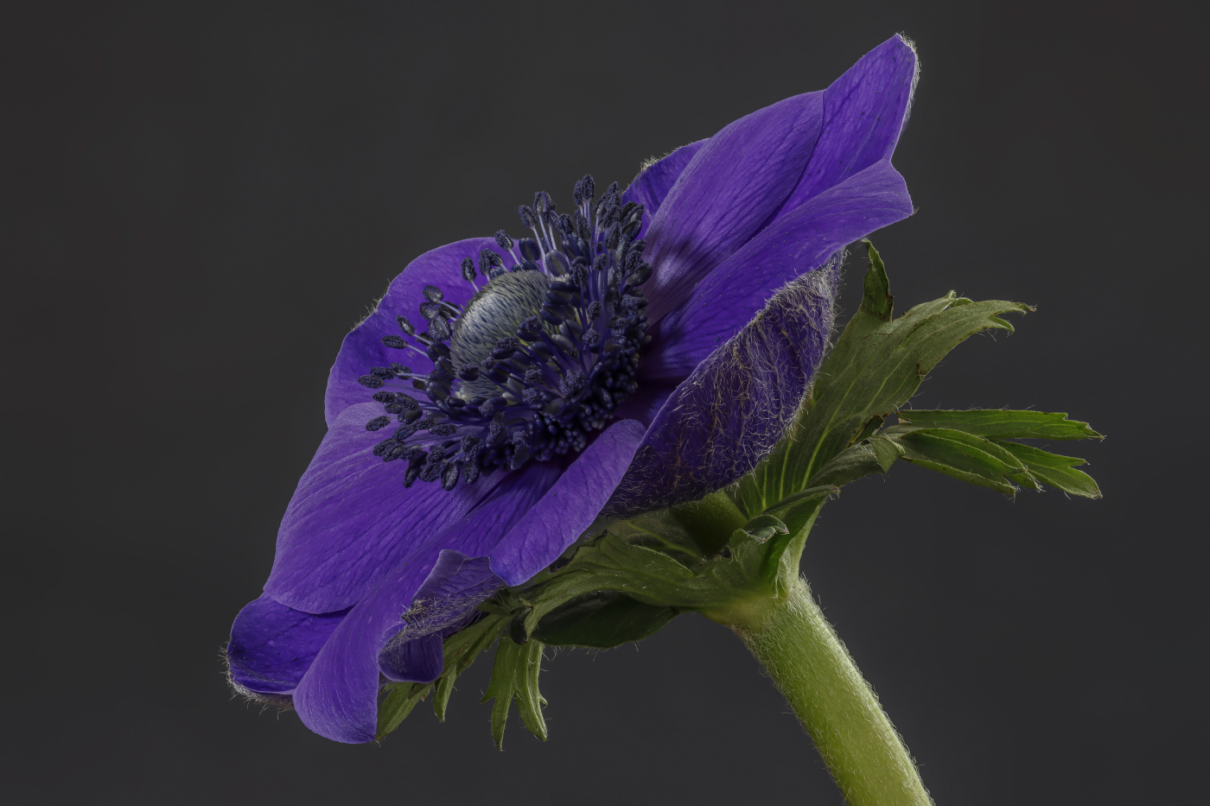
#9
BLUE ANEMONE
#1 EARLY MORNING ROW

Slide 53
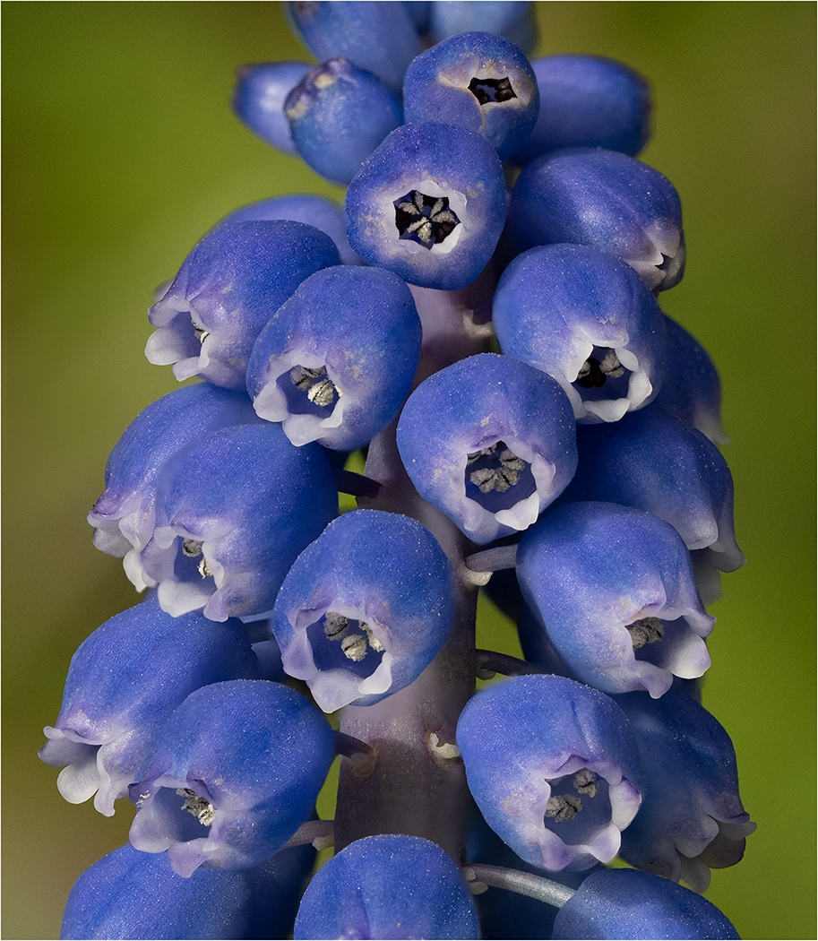
#10
MUSCARI FLOWER DETAIL
#1 EARLY MORNING ROW

Slide 54
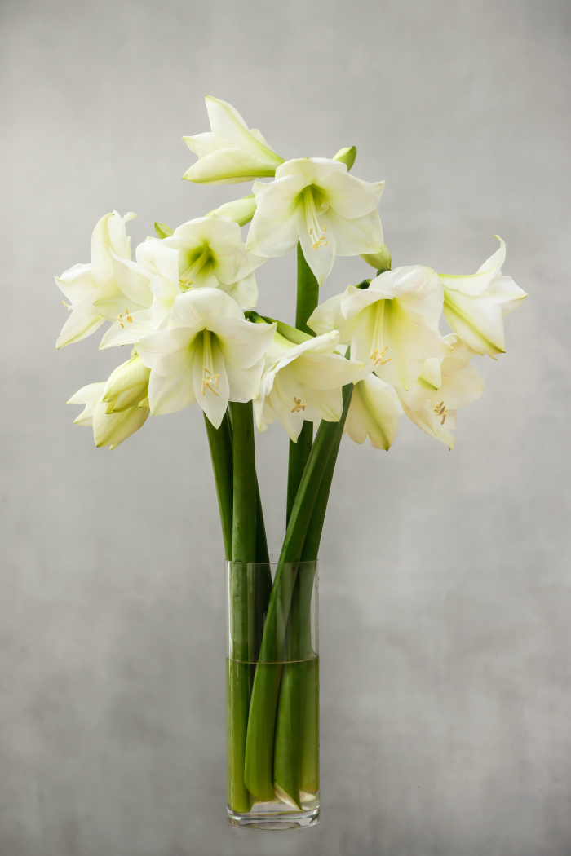
#11
WHITE AMARYLIS

Slide 55
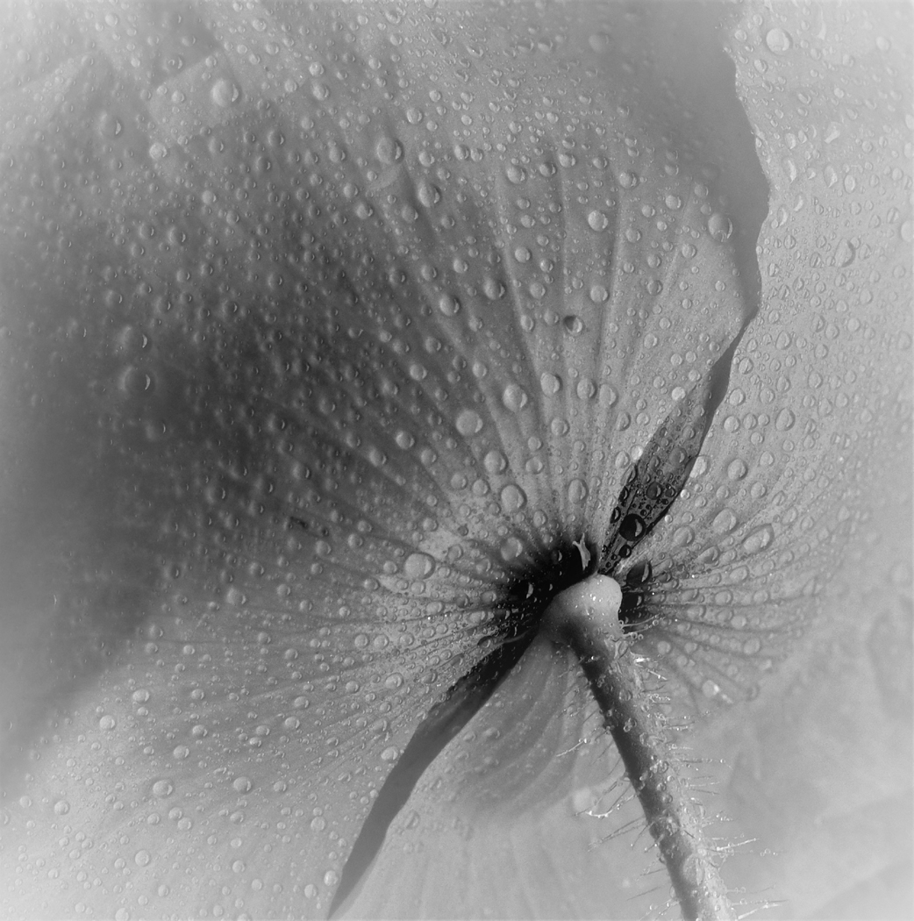
#12
POPPY
#1 EARLY MORNING ROW

Slide 56
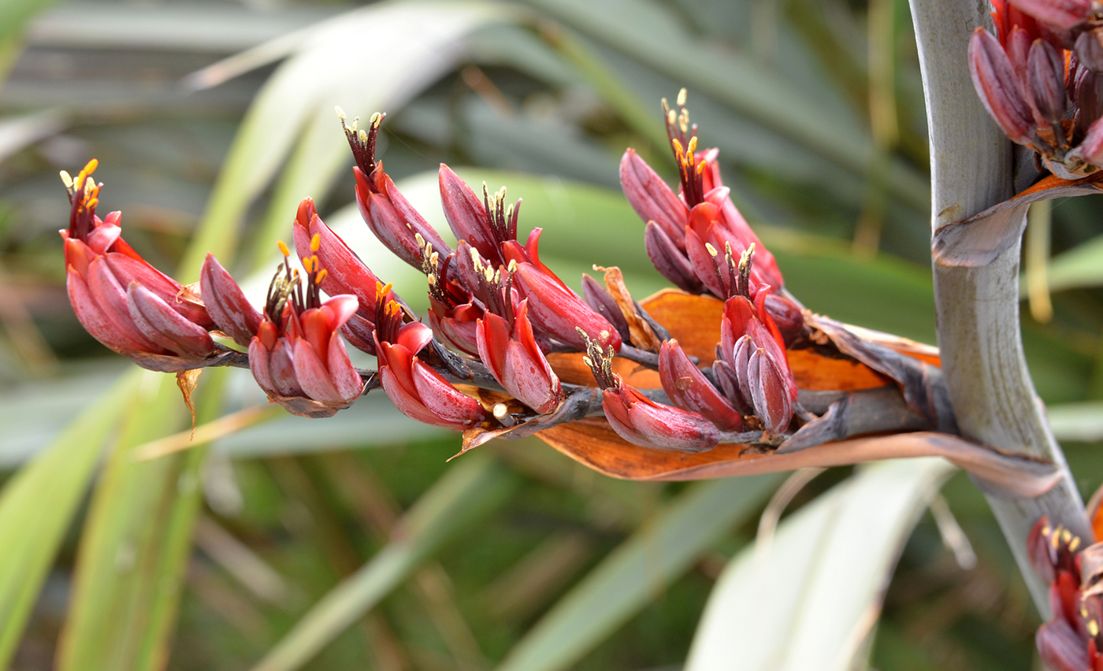
#13
NEW ZEALAND FLAX
#1 EARLY MORNING ROW

Slide 57
#14
WHITE ROSE
#1 EARLY MORNING ROW

Slide 58
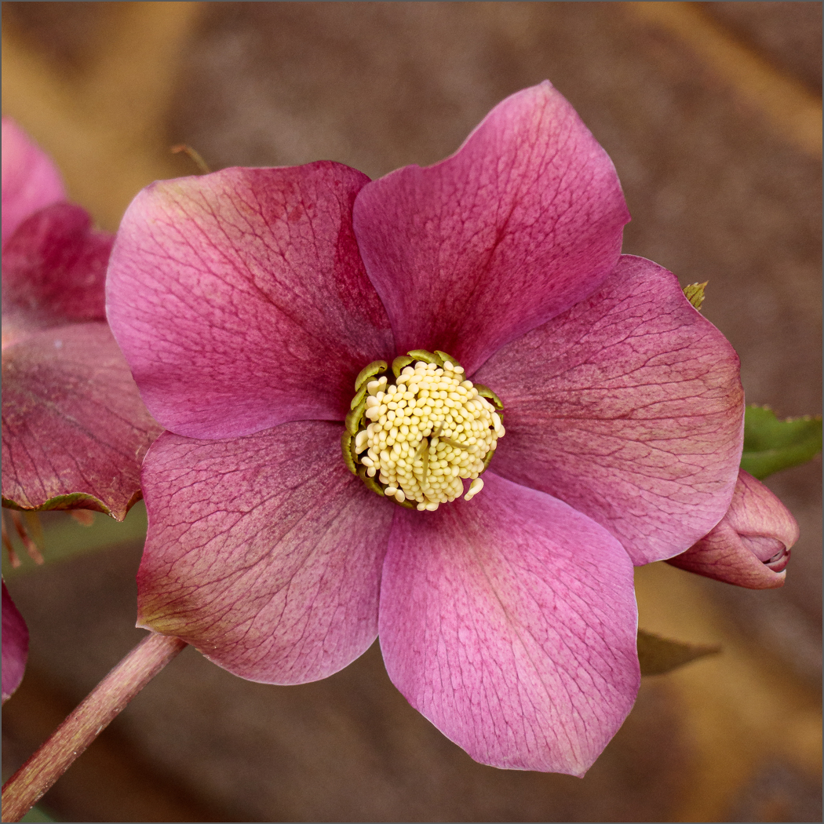
#15
HELEBORE
#1 EARLY MORNING ROW

Slide 59
Commended
#1 EARLY MORNING ROW

Slide 60
PAUL GOBY
#9
BLUE ANEMONE
#1 EARLY MORNING ROW

Slide 61
Highly Commended
#1 EARLY MORNING ROW

Slide 62
CLAIRE WILLIAMS
#1
FADED TULIP
#1 EARLY MORNING ROW

Slide 63
Winner of the
FLORAL cup
#1 EARLY MORNING ROW

Slide 64
HILARY PICKERSGILL#8
FLOWERING CURRANT
#1 EARLY MORNING ROW

Slide 65
Foreign travel
Len rentmore Cup

Slide 66
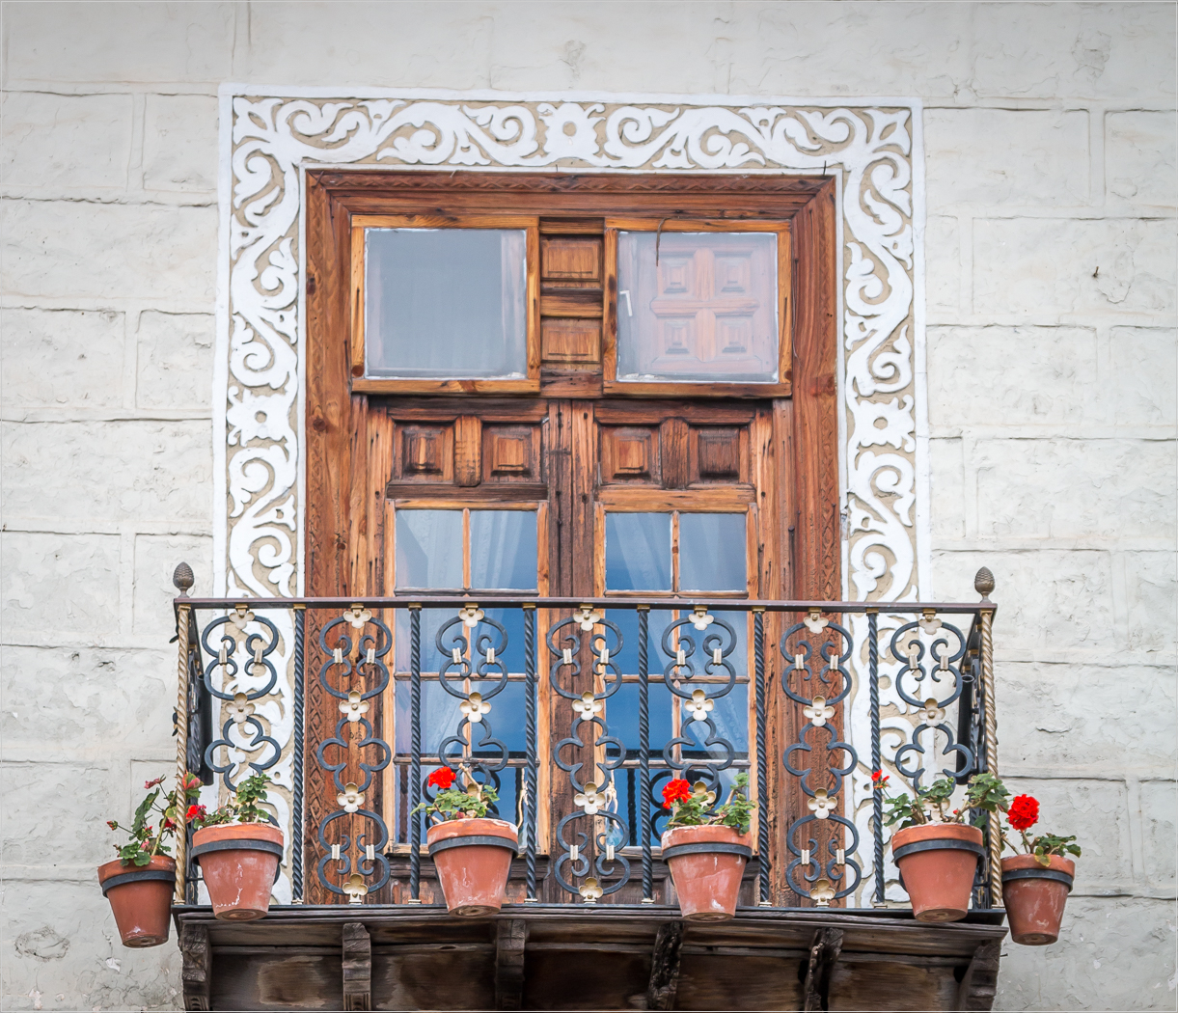
#1
WINDOW & BALCONY
#1 EARLY MORNING ROW

Slide 67
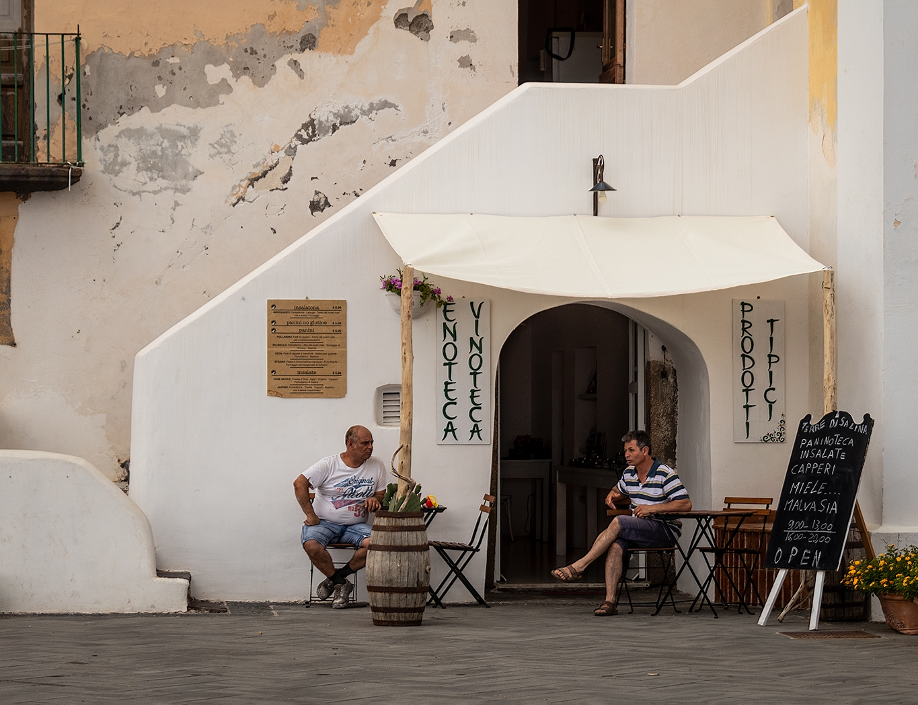
#2
PASSING THE TIME OF DAY
#1 EARLY MORNING ROW

Slide 68
#3
TRACKS IN WADI RUN

Slide 69
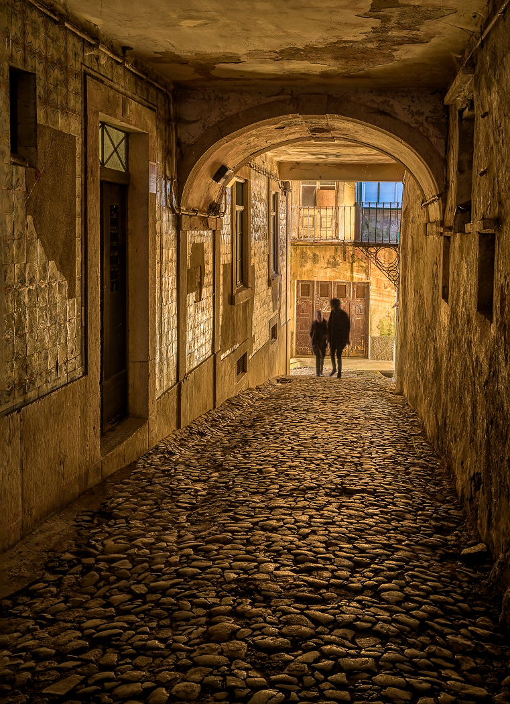
#4
FADED GOLD
#1 EARLY MORNING ROW

Slide 70
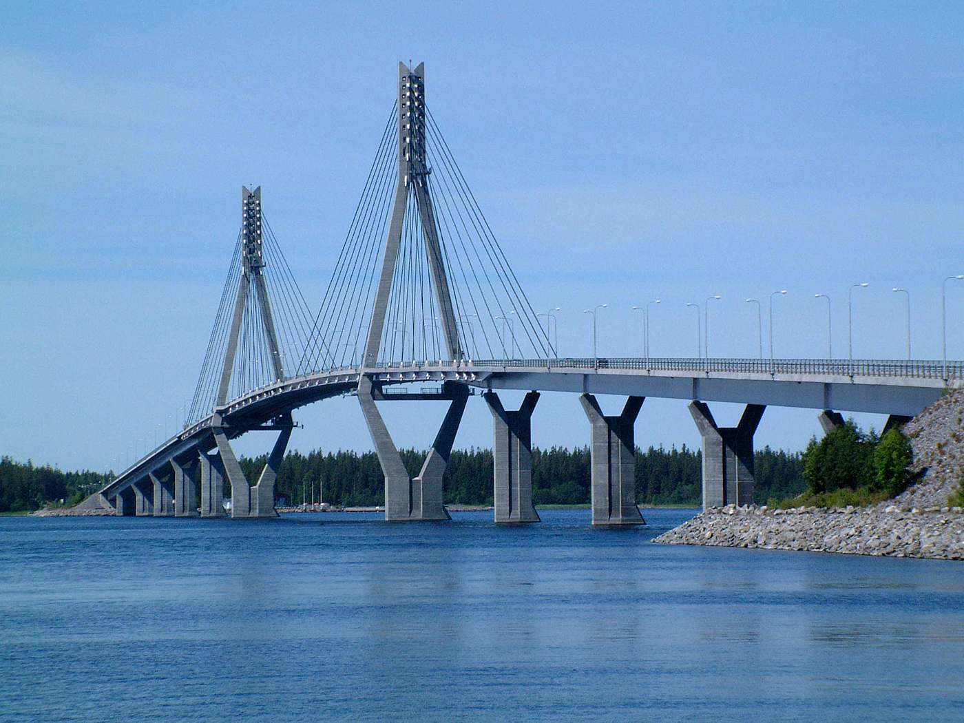
#5
REPLOT BRIDGE
FINLAND
#1 EARLY MORNING ROW

Slide 71
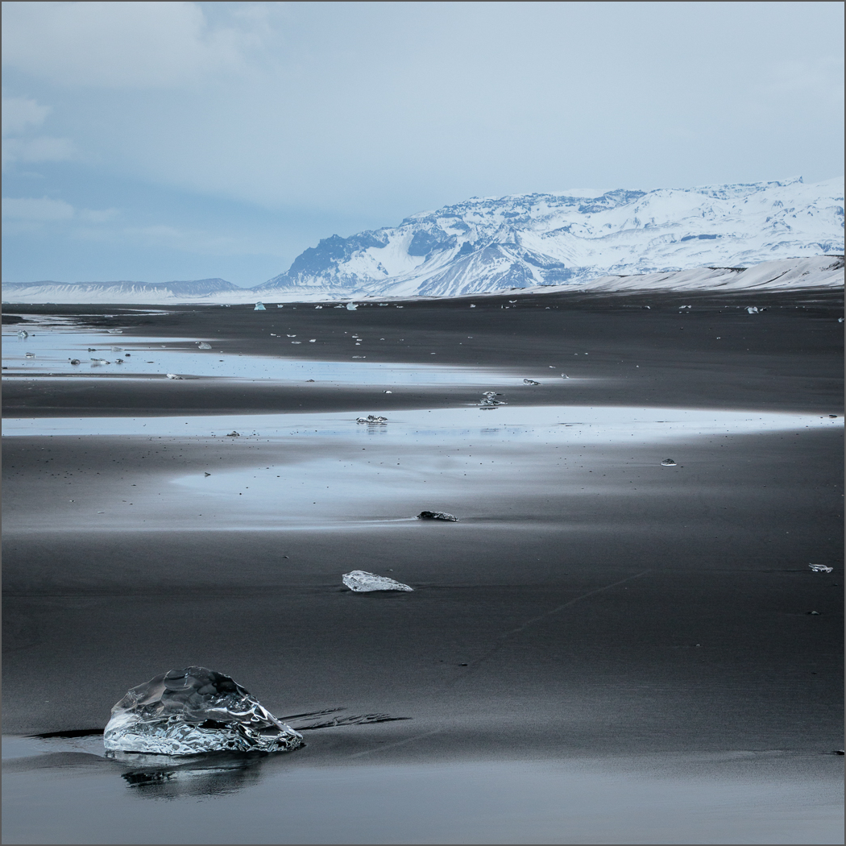
#6
DIAMOND BEACH
#1 EARLY MORNING ROW

Slide 72
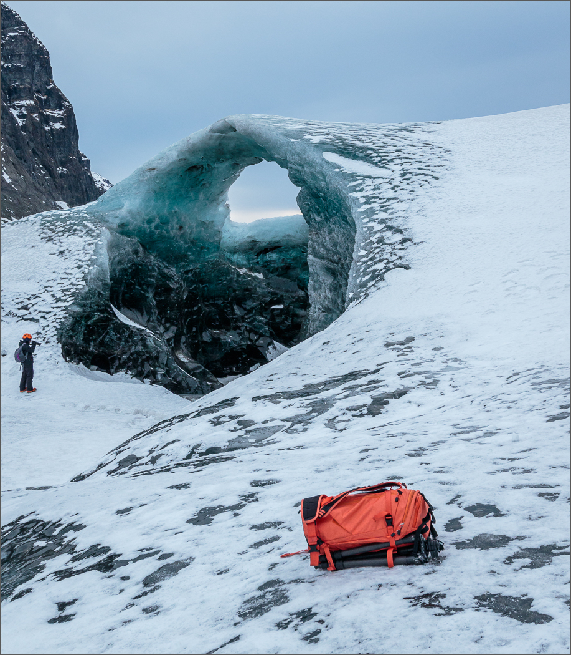
#7
AT THE ICE CAVE
#1 EARLY MORNING ROW

Slide 73
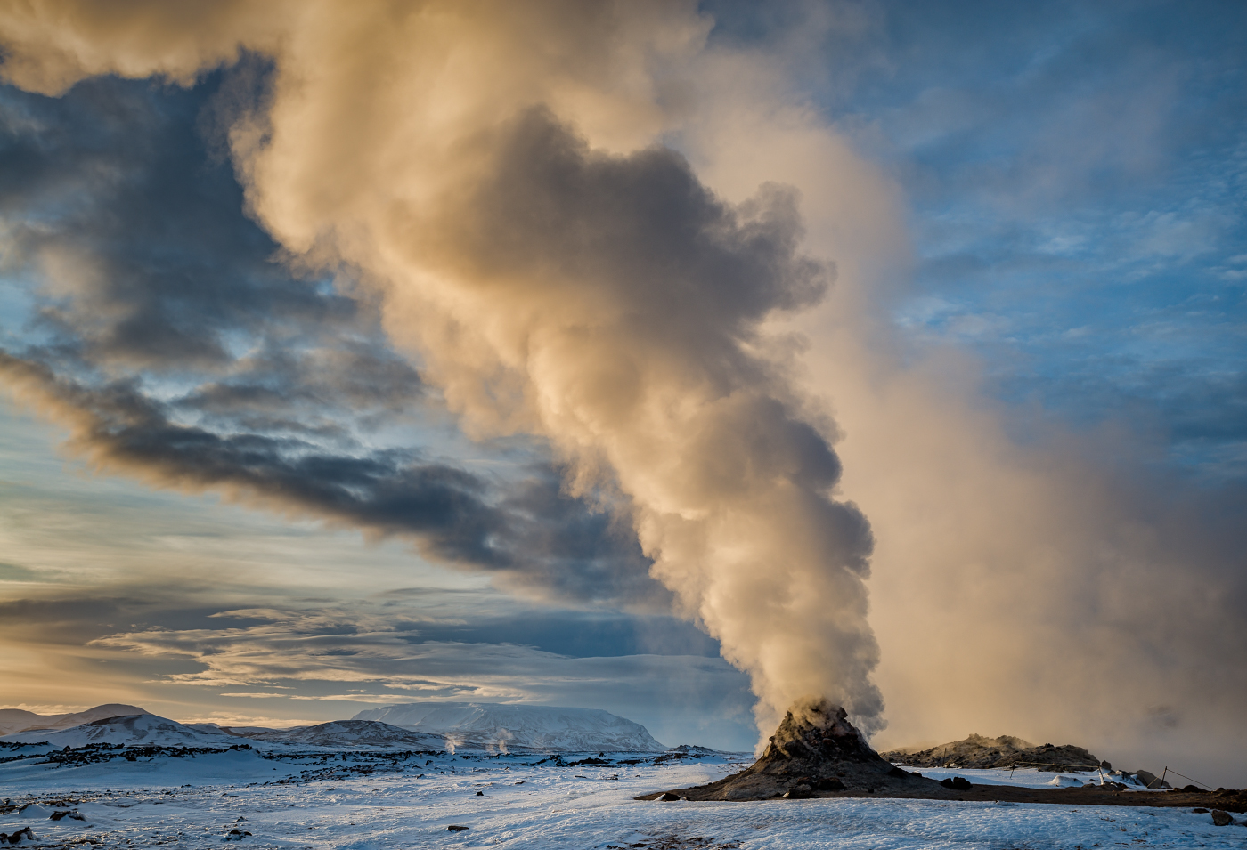
#8
HVERIR FUMEROLE
#1 EARLY MORNING ROW

Slide 74
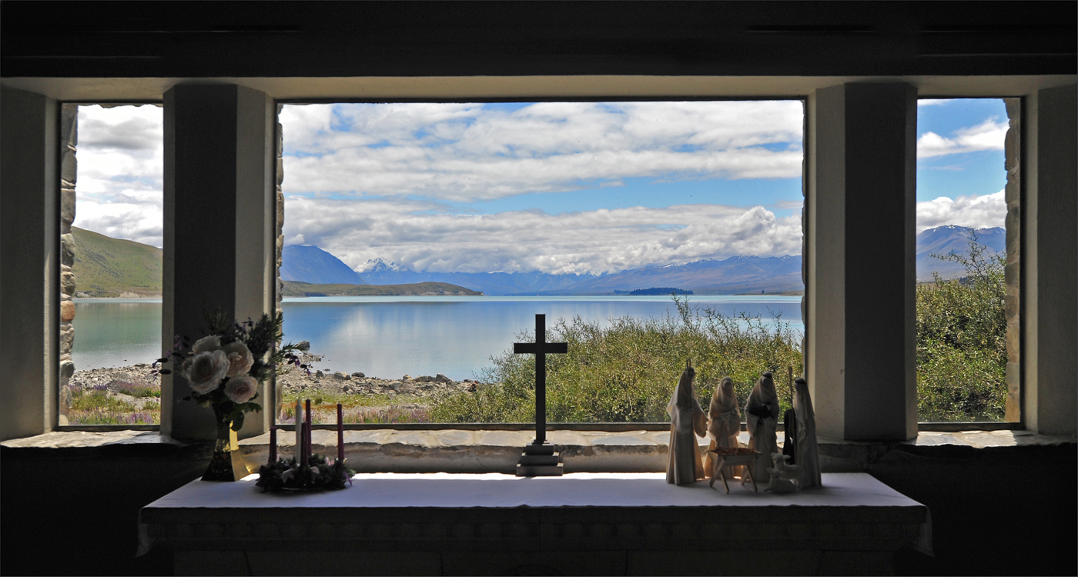
#9
CHURCH OF THE GOOD SHEPHERD

Slide 75
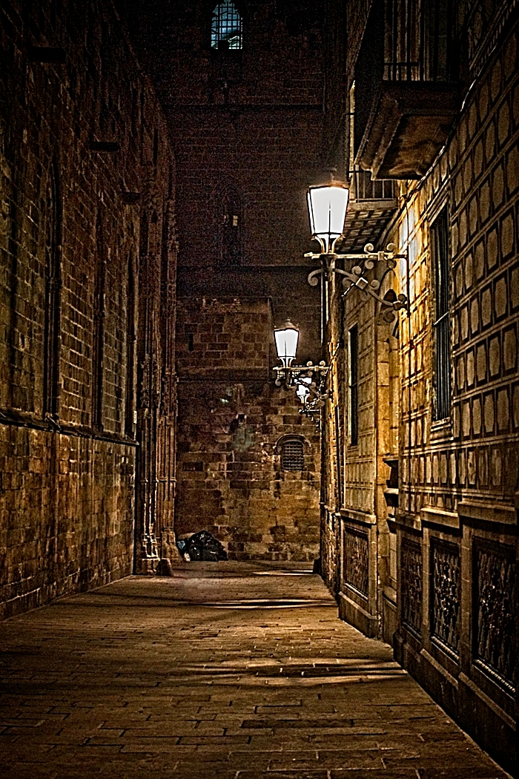
#10
ALLEYWAY BEHIND BARCELONA CATHEDRAL
#1 EARLY MORNING ROW

Slide 76
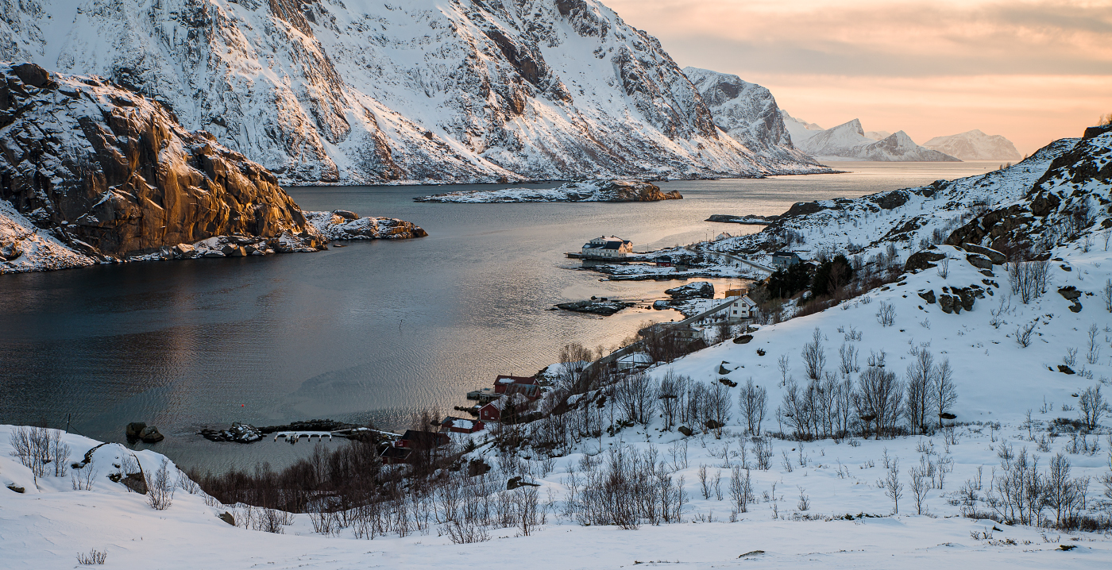
#11
BORSTAD WINTER SUNSET
#1 EARLY MORNING ROW

Slide 77
Commended
#1 EARLY MORNING ROW

Slide 78
Jan Harris
#8
HVERIR FUMEROLE
#1 EARLY MORNING ROW

Slide 79
Highly Commended
#1 EARLY MORNING ROW

Slide 80
JAN HARRIS
#4
FADED GOLD
#1 EARLY MORNING ROW

Slide 81
Winner of the
Len rentmore cup
#1 EARLY MORNING ROW

Slide 82
#1 EARLY MORNING ROW
DAVID HARRIS
#11 BORSTAD WINTER SUNSET

Slide 83
PEOPLE & PORTRAITS
Ron stevens award

Slide 84
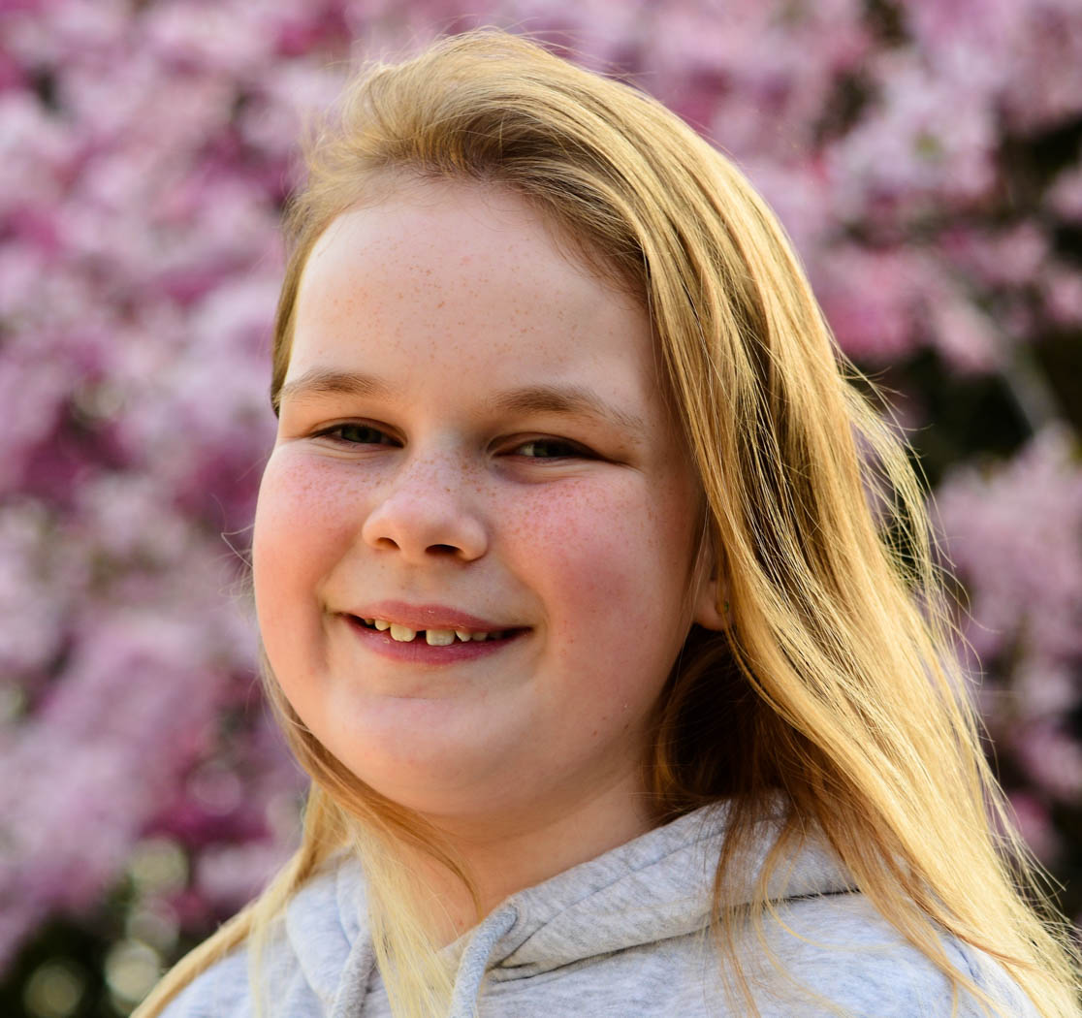
#1
AMALIA
#1 EARLY MORNING ROW

Slide 85
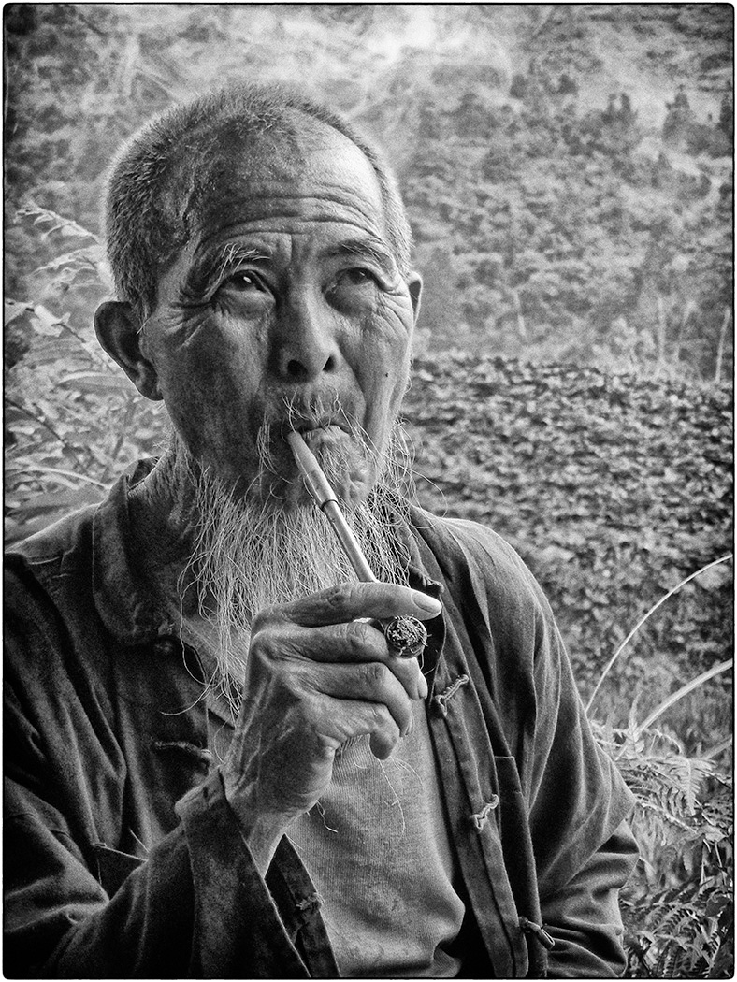
#2
CHINESE PORTER,
PINGAN VILLAGE

Slide 86
#3
AMONGST THE FLOWERS
#1 EARLY MORNING ROW

Slide 87
#4
MARIO
#1 EARLY MORNING ROW

Slide 88
#5
BUFFALO PORTRAIT
#1 EARLY MORNING ROW

Slide 89
#6
TIME TO REFLECT
#1 EARLY MORNING ROW

Slide 90
Winner of the
Ron stevens award
#1 EARLY MORNING ROW

Slide 91
TERESA HEHIR
#5
BUFFALO PORTRAIT
#1 EARLY MORNING ROW

Slide 92
Congratulations
To the following winners
Pat Begley – Best Candid, Action, Decisive Moment, Street Photography – Sue Carey Trophy – Bucking Horse
Carole Dixon – Best Architecture, Technical Record – Percy Thomson Trophy – Vertiginous Lines
Hilary Pickersgill – Best Creative – Castle Cup – Blue Wave
Hilary Pickersgill – Best Cultivated Flowers / Plants – Floral Cup – Flowering Currant
David Harris – Best Foreign Travel – Len Rentmore Cup – Borstad Winter Sunset
Teresa Hehir – Best People and Portraits – Ron Stevens Award – Buffalo Portrait

Slide 93
Congratulations
To the following
Highly commended & commended
Architecture, Technical Record:
Highly Commended – Hilary Pickersgill – Elements of a Bridge
Creative:
Highly Commended – Deena Theaker - Snowdrops
Commended – Allan Marshall – Wintery Rocks
Cultivated Flowers / Plants:
Highly Commended – Claire Williams – Faded Tulip
Commended – Paul Goby – Blue Anemone
Foreign Travel:
Highly Commended - Jan Harris – Faded Gold
Commended – Jan Harris – Hvevir Fumerole

